Slide 1
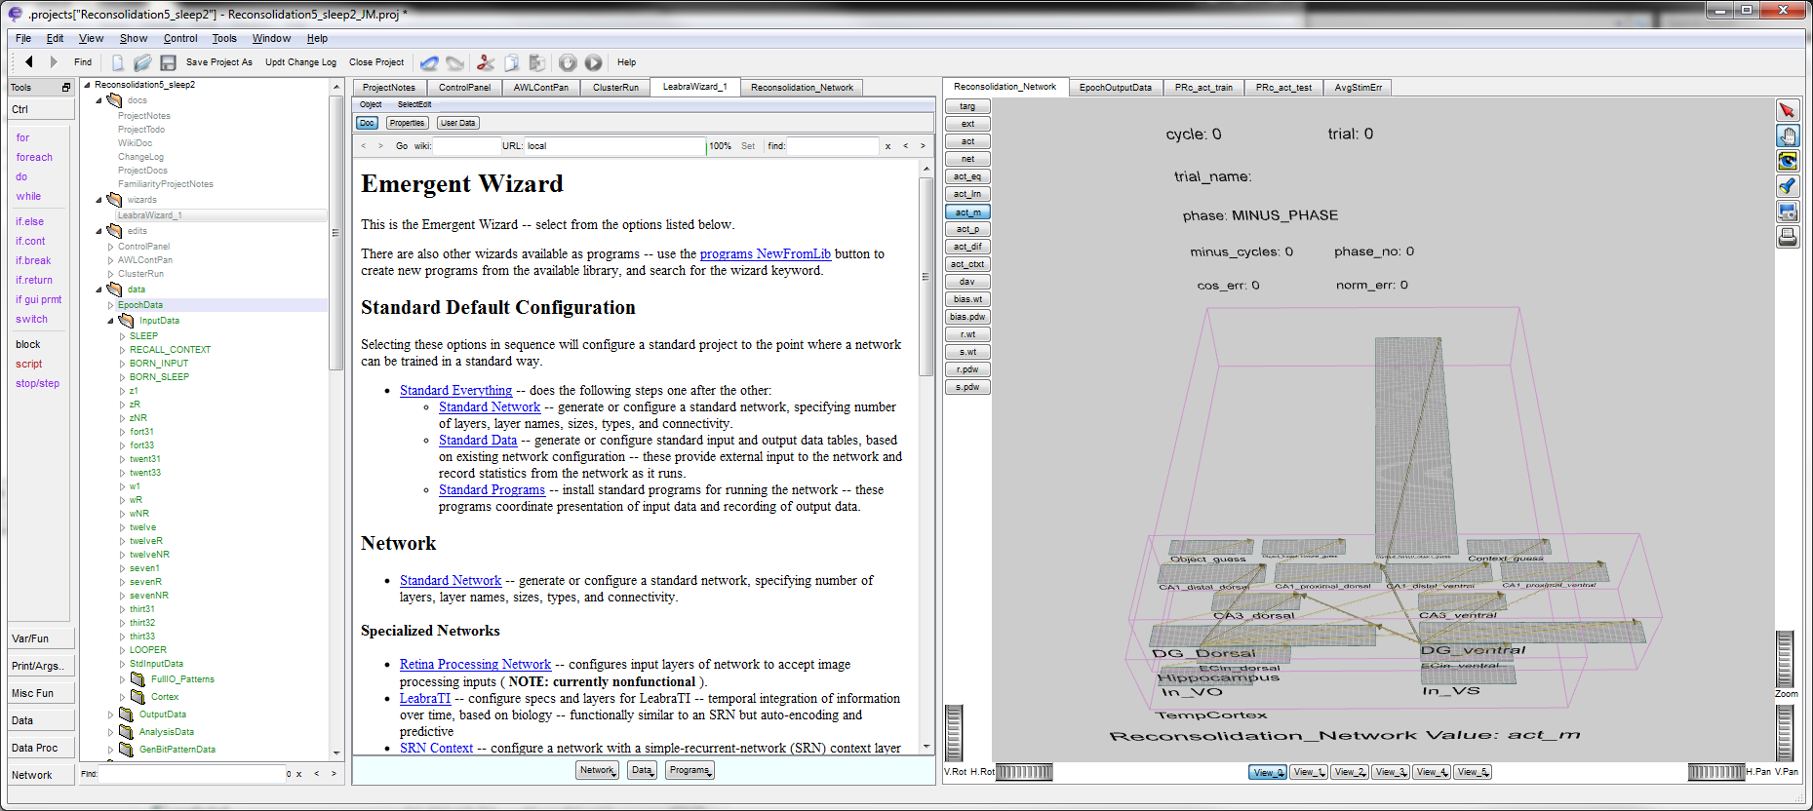
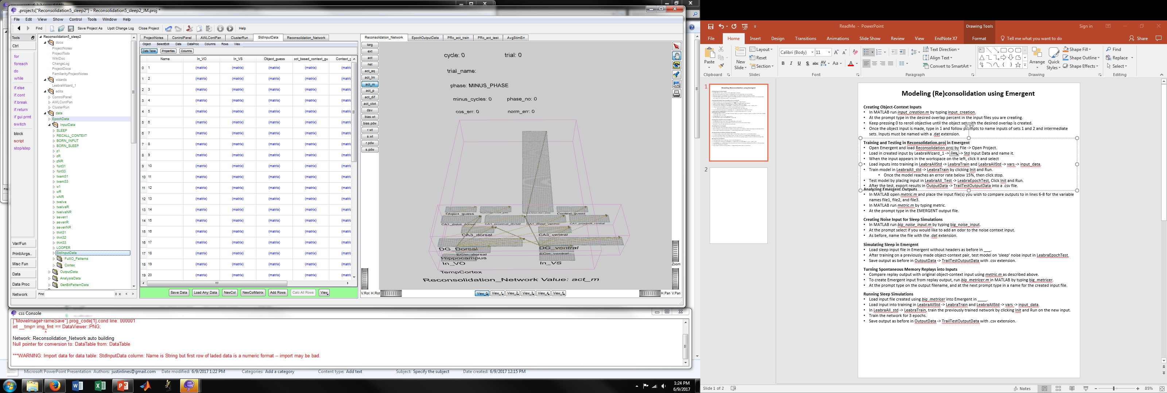
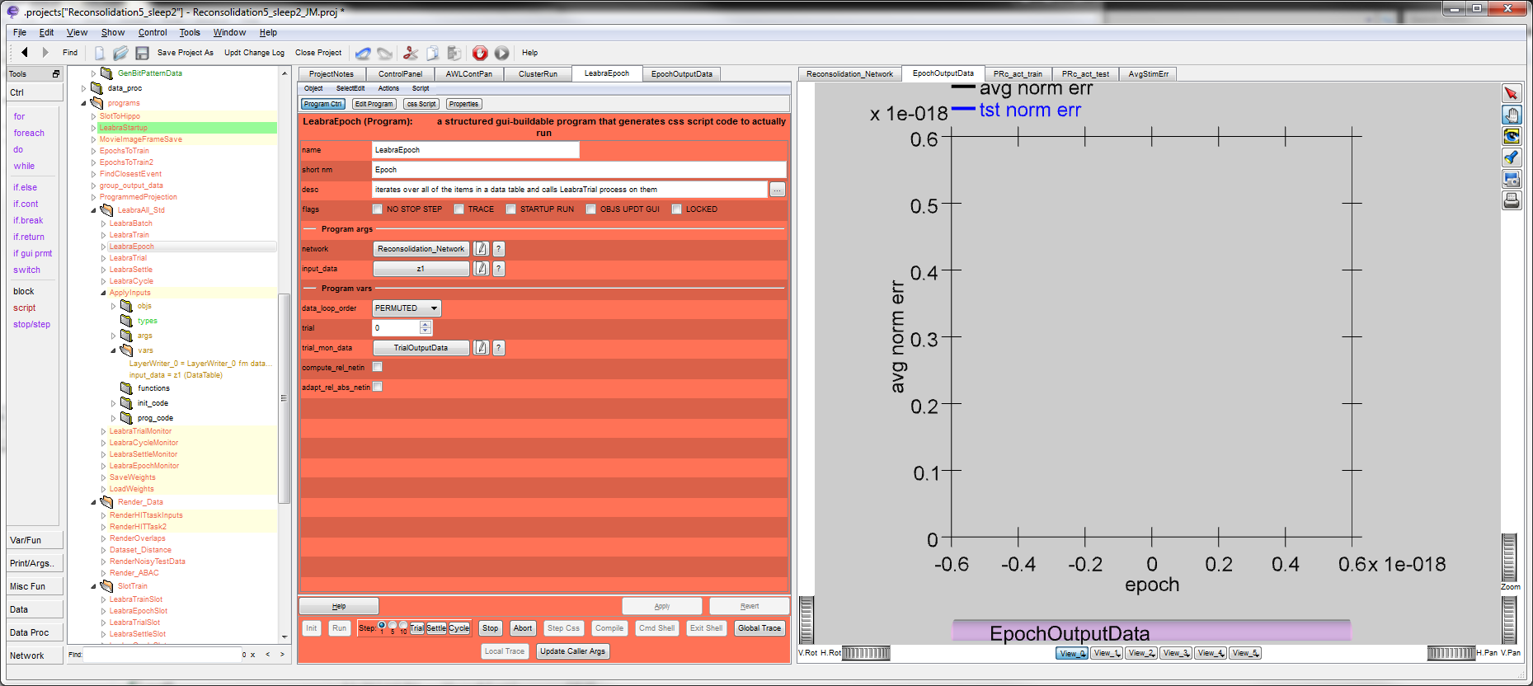
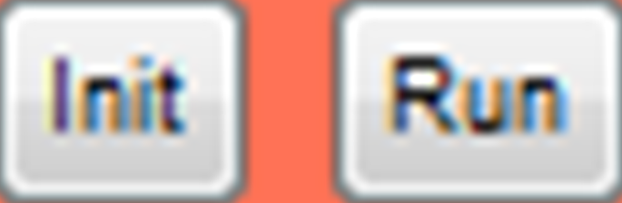
Modeling (Re)consolidation using Emergent
Creating Object-Context Inputs
In MATLAB run input_creation.m by typing input_creation.
At the prompt type in the desired overlap percent in the input files you are creating.
Keep pressing 0 to reroll objective until the object set with the desired overlap is created.
Once the object input is made, type in 1 and follow prompts to name inputs of sets 1 and 2 and intermediate sets. Inputs must be named with a .dat extension.
Training and Testing in Reconsolidation.proj in Emergent
Open Emergent 6.3.2 and load Reconsolidation.proj by File -> Open Project.
Load in created input by LeabraWizard_1 -> -> Std Input Data and name it.
When the input appears in the workspace under InputData, click it and select without headers.
Load inputs into training in LeabraAllStd -> LeabraTrain and LeabraAllStd -> vars -> input_data : object val.
Train model in LeabraAll_std -> LeabraTrain by clicking then .
  Monitor progress in and click when avg norm err is below 0.15.
Test model by placing input in LeabraAll_Test -> LeabraEpochTest, Click Init and Run.
After the test, export results in OutputData -> TrailTestOutputData into a .csv file.
Analyzing Emergent Outputs
In MATLAB open metric.m and place the input file(s) you wish to compare outputs to in lines 6-8 for the variable names file1, file2, and file3.
In MATLAB run metric.m by typing metric.
At the prompt type in the EMERGENT output file.
Creating Noise Input for Sleep Simulations
In MATLAB run big_noise_input.m by typing big_noise_input.
At the prompt select if you would like to add an odor to the noise context input.
As before, name the file with the .dat extension.
Simulating Sleep in Emergent
Load sleep input file in Emergent as before by LeabraWizard_1, Data, Std Input Data, Load Any Data.
After training on a previously made object-context pair, test model on ‘sleep’ noise input in LeabraEpochTest.
Save output as before in OutputData -> TrailTestOutputData with .csv extension.
Turning Spontaneous Memory Replays into Inputs
Compare replay output with original object-context input using metric.m as described above.
To create Emergent input from replay output, run big_metric.m in MATLAB by typing big_metric.
At the prompt type on the output filename, and at the next prompt type in a name for the created input file.
Running Sleep Simulations
Load input file created using big_metric in Emergent by LeabraWizard_1, Data, Std Input Data, Load Any Data.
Load input into training in LeabraAllStd -> LeabraTrain and LeabraAllStd -> vars -> input_data.
In LeabraAll_std -> LeabraTrain, train the previously trained network by clicking Init and Run on the new input.
Train the network for 3 epochs.
Save output as before in OutputData -> TrailTestOutputData with .csv extension.

