Slide 1
Associative Memory in Neural Network
Adam Lester
NRSC 506
Oct 28th, 2011

Slide 2
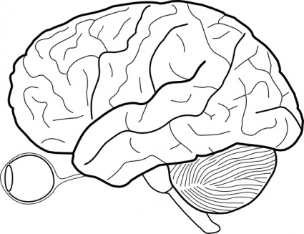
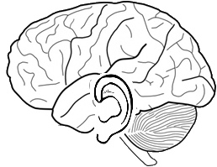
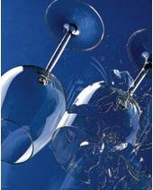
Associative Memory As applied to “pattern completion”
What is associative memory?
Associative memory describes the storage of information in a neural network such that the input of some part of that information will be sufficient to activate a complete representation…
Storage
Simultaneous sensory inputs produces an association
Retrieval
Incomplete input will activates full
sensory representation
“CHRASH”
Pattern completion
“CHRASH”
“Neurons that fire together wire together” and that applies to neural ensembles too!

Slide 3
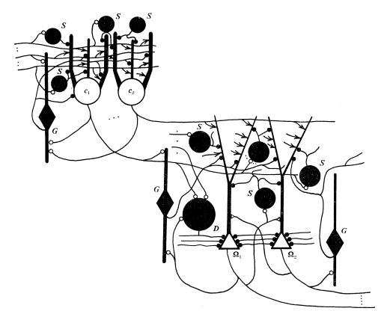
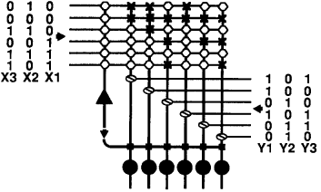
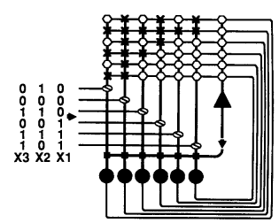
Associative Memory As applied to “pattern completion”
Mathematical models of associative memory:
modifying synaptic weights
Hebb-Marr Model
McNaughton-Morris model
1987
The first neural network model to formalized a mechanism for Hebbian plasticity in the storage of associations in synaptic weights
Neural network model of associative memory which describes synaptic weights in terms of a correlation matrix
Heteroassociative
“CHRASH”
Encodeing
Autoassociative
“CHRASH”
Will allow for pattern completion of broken glass image from degraded inputs

Slide 4
Associative Memory Associating object and context
The following example is used to illustrate how the principles of associative memory can be applied to contextual learning
Object
Paul the grad student
Features
Sallow complexion
2) Receding Hair Line
3) Sunken eyes
4) Five-o-clock shadow

Slide 5
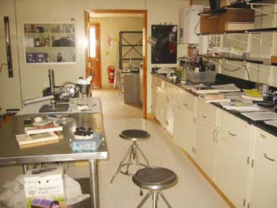
Associative Memory Associating object and context
Object
Paul the grad student
Features
Sallow complexion
2) Receding Hair Line
3) Sunken eyes
4) Five-o-clock shadow
1 | 0 | 0 | 1
0 | 1 | 1 | 0
1 | 0 | 1 | 0
0 | 1 | 0 | 1
Context A
Paul’s research lab
Features
Science stuff
Science stuff
Science stuff
Science stuff
0 | 0 | 1 | 1
0 | 0 | 1 | 1
0 | 0 | 1 | 1
0 | 0 | 1 | 1

Slide 6
Associative Memory Associating object and context
Paul in context
Observe Paul in his native habitat
Object
Paul the grad student
Context A
Paul’s research lab
Sallow complexion
2) Receding Hair Line
3) Sunken eyes
4) Five-o-clock shadow
Science stuff
Science stuff
Science stuff
Science stuff
1 | 0 | 0 | 1
0 | 1 | 1 | 0
1 | 0 | 1 | 0
0 | 1 | 0 | 1
0 | 0 | 1 | 1
0 | 0 | 1 | 1
0 | 0 | 1 | 1
0 | 0 | 1 | 1

Slide 7
Associative Memory Associating object and context
Paul in context
Observe Paul in his native habitat
Combine Object & Context
Object
Paul the grad student
Context A
Paul’s research lab
Sallow complexion/ Science stuff
2) Receding Hair Line / Science stuff
3) Sunken eyes / Science stuff
4) Five-o-clock shadow / Science stuff
1 | 0 | 0 | 1
0 | 1 | 1 | 0
1 | 0 | 1 | 0
0 | 1 | 0 | 1
0 | 0 | 1 | 1
0 | 0 | 1 | 1
0 | 0 | 1 | 1
0 | 0 | 1 | 1

Slide 8
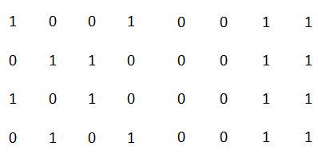
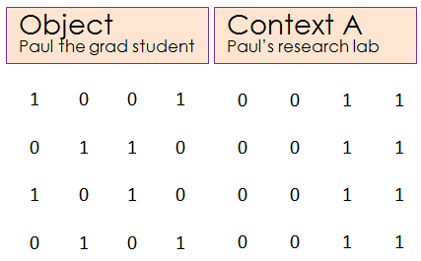
Associative Memory The McNaughton-Morris Model with autoassociative input
An attempt at translating between the Hebb-Marr model and the McNaughton-Morris model...
Synapses
Synapse absent
Synapse Established
Detonator Synapses
Inhibitory Synapse
Synaptic Weight Matrix
Neurons
Output Cell
Inhibitory Cell
Sallow complexion/ Science stuff
2) Receding Hair Line / Science stuff
3) Sunken eyes / Science stuff
4) Five-o-clock shadow / Science stuff
Object
Paul the grad student
Context A
Paul’s research lab

Slide 9
Associative Memory The “Complete” Hebb-Marr Model
An attempt at translating between the Hebb-Marr model and the McNaughton-Morris model...
Synapses
Synapse absent
Synapse Established
Detonator Synapses
Inhibitory Synapse
Neurons
Output Cell
Inhibitory Cell

Slide 10
Associative Memory The “Complete” Hebb-Marr Model
An attempt at translating between the Hebb-Marr model and the McNaughton-Morris model...
Input from another codon cell
Inhibitory cells Types:
S: Substractive
G: Substractive
D: Divisive
S
: Subtracts “un-modifiable” excitatory component of the input
G
G
: Subtracts (normalize to) number of inputs
S
Raw input of some form ???
S
S
D
: Divides final output by all codon cell inputs
Ω
: Outputs and stores memory during recoding and recall
Codon
Cell
: Encodes input relationship and (to my understanding) may be used to separate input patterns

Slide 11
Associative Memory The “Complete” Hebb-Marr Model
An attempt at translating between the Hebb-Marr model and the McNaughton-Morris model...
Assumptions:
inhibition applied to dendrite will be subtractive
2) Inhibition applied to soma will be capable of performing division
Feed forward inhibition
(substraction)
Input from another codon cell
Inhibitory cells Types:
S: Substractive
G: Substractive
D: Divisive
S
: Subtracts “un-modifiable” excitatory component of the input
G
G
: Subtracts (normalize to) number of inputs
S
Raw input of some form ???
S
Feedback inhibition
(substraction)
S
D
: Divides final output by all codon cell inputs
Ω
: Outputs and stores memory during recoding and recall
Codon
Cell
: Encodes input relationship and (to my understanding) may be used to separate input patterns
Feedback inhibition
(division)
Explicitly modeled by McNaughton-Morris
As well

Slide 12
Encoding Associating object and context
Autoassociation in the synaptic weight matrix
Paul in context
Observe Paul in his native habitat
Synapses
Synapse absent
Synapse Established
Detonator Synapses
Inhibitory Synapse
Neurons
Output Cell
Inhibitory Cell
Sallow complexion/ Science stuff
2) Receding Hair Line / Science stuff
3) Sunken eyes / Science stuff
4) Five-o-clock shadow / Science stuff
Object
Paul the grad student
Context A
Paul’s research lab

Slide 13
Encoding Associating object and context
Autoassociation in the synaptic weight matrix
Paul in context
Observe Paul in his native habitat
Synapses
Synapse absent
Synapse Established
Detonator Synapses
Inhibitory Synapse
Neurons
Output Cell
Inhibitory Cell
Sallow complexion/ Science stuff
2) Receding Hair Line / Science stuff
3) Sunken eyes / Science stuff
4) Five-o-clock shadow / Science stuff
Synapses between the two input sources are not present prior to “learning” the associations
Object
Paul the grad student
Context A
Paul’s research lab

Slide 14
Encoding Associating object and context
Autoassociation in the synaptic weight matrix
Paul in context
Observe Paul in his native habitat
Synapses
Synapse absent
Synapse Established
Detonator Synapses
Inhibitory Synapse
Neurons
Output Cell
Inhibitory Cell
Input
Sallow complexion/ Science stuff
2) Receding Hair Line / Science stuff
3) Sunken eyes / Science stuff
4) Five-o-clock shadow / Science stuff
Synapses are Hebbian in that they are formed only when both inputs are co-activated in time (i.e both have a value of 1)
Object
Paul the grad student
Context A
Paul’s research lab
Input

Slide 15
Encoding Associating object and context
Autoassociation in the synaptic weight matrix
Paul in context
Observe Paul in his native habitat
Synapses
Synapse absent
Synapse Established
Detonator Synapses
Inhibitory Synapse
Neurons
Output Cell
Inhibitory Cell
Input
Sallow complexion/ Science stuff
2) Receding Hair Line / Science stuff
3) Sunken eyes / Science stuff
4) Five-o-clock shadow / Science stuff
The correlation matrix can store overlaid distributions of connection strengths making up the various consecutive associations being created
Object
Paul the grad student
Context A
Paul’s research lab
Input

Slide 16
Encoding Associating object and context
Autoassociation in the synaptic weight matrix
Paul in context
Observe Paul in his native habitat
Synapses
Synapse absent
Synapse Established
Detonator Synapses
Inhibitory Synapse
Neurons
Output Cell
Inhibitory Cell
Input
Sallow complexion/ Science stuff
2) Receding Hair Line / Science stuff
3) Sunken eyes / Science stuff
4) Five-o-clock shadow / Science stuff
Object
Paul the grad student
Context A
Paul’s research lab
Input

Slide 17
Encoding Associating object and context
Autoassociation in the synaptic weight matrix
Paul in context
Observe Paul in his native habitat
Synapses
Synapse absent
Synapse Established
Detonator Synapses
Inhibitory Synapse
Neurons
Output Cell
Inhibitory Cell
Input
Sallow complexion/ Science stuff
2) Receding Hair Line / Science stuff
3) Sunken eyes / Science stuff
4) Five-o-clock shadow / Science stuff
Object
Paul the grad student
Context A
Paul’s research lab
Input

Slide 18
Encoding Associating object and context
Autoassociation in the synaptic weight matrix
Paul in context
Observe Paul in his native habitat
Synapses
Synapse absent
Synapse Established
Detonator Synapses
Inhibitory Synapse
Neurons
Output Cell
Inhibitory Cell
Input
Sallow complexion/ Science stuff
2) Receding Hair Line / Science stuff
3) Sunken eyes / Science stuff
4) Five-o-clock shadow / Science stuff
Object
Paul the grad student
Context A
Paul’s research lab
Input

Slide 19
Encoding Associating object and context
Autoassociation in the synaptic weight matrix
Paul in context
Observe Paul in his native habitat
Synapses
Synapse absent
Synapse Established
Detonator Synapses
Inhibitory Synapse
Neurons
Output Cell
Inhibitory Cell
Correlation Matrix
1 | 0 | 1 | 1 | 0 | 0 | 1 | 1
0 | 1 | 1 | 1 | 0 | 0 | 1 | 1
1 | 1 | 1 | 0 | 0 | 0 | 1 | 1
1 | 1 | 0 | 1 | 0 | 0 | 1 | 1
0 | 0 | 0 | 0 | 0 | 0 | 0 | 0
0 | 0 | 0 | 0 | 0 | 0 | 0 | 0
1 | 1 | 1 | 1 | 0 | 0 | 1 | 1
1 | 1 | 1 | 1 | 0 | 0 | 1 | 1
Object
Paul the grad student
Context A
Paul’s research lab

Slide 20
Encoding Associating object and context
Autoassociation in the synaptic weight matrix
Paul in context
Observe Paul in his native habitat
Synapses
Synapse absent
Synapse Established
Detonator Synapses
Inhibitory Synapse
Neurons
Output Cell
Inhibitory Cell
Correlation Matrix
Object
Paul the grad student
Context A
Paul’s research lab

Slide 21
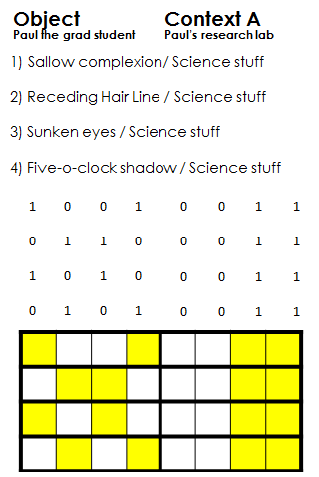
Encoding Associating object and context
Autoassociation in the synaptic weight matrix
Paul in context
Observe Paul in his native habitat
correlation matrix
The synaptic weight matrix we just made can also be produced through taking the “OR of the Outer product” to produce a correlation matrix
Notes:
Connection weght matrix de

Slide 22
Encoding Associating object and context
Autoassociation in the correlation matrix
Paul in context
Observe Paul in his native habitat
Scalar by vector multiplication
Notes:
Connection weght matrix de

Slide 23
Retrieval Associating object and context
Autoassociation, READING OUT the synaptic weight matrix
Paul in context
Observe Paul in his native habitat
Synapses
Synapse absent
Synapse Established
Detonator Synapses
Inhibitory Synapse
Neurons
Output Cell
Inhibitory Cell
Object
Paul the grad student
Context A
Paul’s research lab

Slide 24
Retrieval Associating object and context
Autoassociation, READING OUT the synaptic weight matrix
Paul in context
Observe Paul in his native habitat
Synapses
Synapse absent
Synapse Established
Detonator Synapses
Inhibitory Synapse
Neurons
Output Cell
Inhibitory Cell
Input
All synapses which the input cross are activated
4
Input
2
2
3
3
0
0
3
3

Slide 25
Retrieval Associating object and context
Autoassociation, READING OUT the synaptic weight matrix
Paul in context
Observe Paul in his native habitat
Synapses
Synapse absent
Synapse Established
Detonator Synapses
Inhibitory Synapse
Neurons
Output Cell
Inhibitory Cell
Input
Output cells are activated in a graded manner directly proportional to the number of active pre-synaptic inputs they receive
4
Input
2
2
3
3
0
0
3
3

Slide 26
Retrieval Associating object and context
Autoassociation, READING OUT the synaptic weight matrix
Paul in context
Observe Paul in his native habitat
Synapses
Synapse absent
Synapse Established
Detonator Synapses
Inhibitory Synapse
Neurons
Output Cell
Inhibitory Cell
Input
All synapses on our inhibitory cell which are contacted by an active projection are also active
4
Input
2
2
3
3
0
0
3
3

Slide 27
Retrieval Associating object and context
Autoassociation, READING OUT the synaptic weight matrix
Paul in context
Observe Paul in his native habitat
Synapses
Synapse absent
Synapse Established
Detonator Synapses
Inhibitory Synapse
Neurons
Output Cell
Inhibitory Cell
Input
The inhibitory neuron is also activated in a graded manner, proportional to the number of active pre-synaptic inputs it receives
As such, it will “divide” the activation in our output cells by the number of active input projections
4
Input
2
2
3
3
0
0
3
3

Slide 28
Retrieval Associating object and context
Autoassociation, READING OUT the synaptic weight matrix
Paul in context
Observe Paul in his native habitat
Synapses
Synapse absent
Synapse Established
Detonator Synapses
Inhibitory Synapse
Neurons
Output Cell
Inhibitory Cell
Input
Notice also that all inhibitory inputs on our output cells are active, to the degree that the inhibitory neuron is activated
The result is that all output cells receive the same divisive input (at the soma?)
4
Input
2
2
3
3
0
0
3
3

Slide 29
Retrieval Associating object and context
Autoassociation, READING OUT the synaptic weight matrix
Paul in context
Observe Paul in his native habitat
Synapses
Synapse absent
Synapse Established
Detonator Synapses
Inhibitory Synapse
Neurons
Output Cell
Inhibitory Cell
Input
4
Input
WTF!
Division with decimal truncation (rounding)
2 2 3 3 0 0 3 3
Output
4
= 00110011
2
2
3
3
0
0
3
3

Slide 30
Retrieval Associating object and context
Autoassociation, READING OUT the correlation matrix
Paul in context
Observe Paul in his native habitat
Taking the inner Product
Correlation Matrix
1 | 0 | 1 | 1 | 0 | 0 | 1 | 1
0 | 1 | 1 | 1 | 0 | 0 | 1 | 1
1 | 1 | 1 | 0 | 0 | 0 | 1 | 1
1 | 1 | 0 | 1 | 0 | 0 | 1 | 1
0 | 0 | 0 | 0 | 0 | 0 | 0 | 0
0 | 0 | 0 | 0 | 0 | 0 | 0 | 0
1 | 1 | 1 | 1 | 0 | 0 | 1 | 1
1 | 1 | 1 | 1 | 0 | 0 | 1 | 1
Notes:
Connection weght matrix de

Slide 31
Retrieval Associating object and context
Autoassociation, READING OUT the correlation matrix
Paul in context
Observe Paul in his native habitat
Taking the inner Product
Correlation Matrix
1/1 | 0/0 | 1/0 | 1/1 | 0/0 | 0/0 | 1/1 | 1/1
0 | 1 | 1 | 1 | 0 | 0 | 1 | 1
1 | 1 | 1 | 0 | 0 | 0 | 1 | 1
1 | 1 | 0 | 1 | 0 | 0 | 1 | 1
0 | 0 | 0 | 0 | 0 | 0 | 0 | 0
0 | 0 | 0 | 0 | 0 | 0 | 0 | 0
1 | 1 | 1 | 1 | 0 | 0 | 1 | 1
1 | 1 | 1 | 1 | 0 | 0 | 1 | 1
= 4
= 3
= 3
= 4
= 0
= 0
= 4
= 4
4 3 3 4 0 0 4 4
4
= 10110011
Hooray!
Notes:
Connection weght matrix de

Slide 32
Retrieval Associating object and context
Pattern Completion, READING OUT the synaptic weight matrix
Paul in context (sort of)
Observe Paul in his native habitat
Synapses
Synapse absent
Synapse Established
Detonator Synapses
Inhibitory Synapse
Neurons
Output Cell
Inhibitory Cell
Someone brought their engine blocks to the lab!
Incomplete
Input
3
Fewer inhibitory synapses activated
Input
Double
WTF!
Division with decimal truncation (rounding)
2 1 2 2 0 0 2 2
Output
3
= 10110011
2
1
2
2
0
0
2
2

Slide 33
Retrieval Associating object and context
Pattern Completion, READING OUT the correlation matrix
Paul in context (sort of)
Observe Paul in his native habitat
Taking the inner Product
Correlation Matrix
1 | 0 | 1 | 1 | 0 | 0 | 1/0 | 1
0 | 1 | 1 | 1 | 0 | 0 | 1/0 | 1
1 | 1 | 1 | 0 | 0 | 0 | 1/0 | 1
1 | 1 | 0 | 1 | 0 | 0 | 1/0 | 1
0 | 0 | 0 | 0 | 0 | 0 | 0/0 | 0
0 | 0 | 0 | 0 | 0 | 0 | 0/0 | 0
1 | 1 | 1 | 1 | 0 | 0 | 1/0 | 1
1 | 1 | 1 | 1 | 0 | 0 | 1/0 | 1
= 3
= 2
= 2
= 3
= 0
= 0
= 3
= 3
Again with the engine block !
3 2 2 3 0 0 3 3
3
= 10010011
Hazah!
Notes:
Connection weght matrix de

Slide 34
Retrieval Associating object and context
Pattern Completion, READING OUT the correlation matrix
Hung Over Paul in context
Paul after a long night of “rethinking” his carrier choice
Taking the inner Product
Correlation Matrix
1 | 0 | 1/0 | 1 | 0 | 0 | 1 | 1
0 | 1 | 1/0 | 1 | 0 | 0 | 1 | 1
1 | 1 | 1/0 | 0 | 0 | 0 | 1 | 1
1 | 1 | 0/0 | 1 | 0 | 0 | 1 | 1
0 | 0 | 0/0 | 0 | 0 | 0 | 0 | 0
0 | 0 | 0/0 | 0 | 0 | 0 | 0 | 0
1 | 1 | 1/0 | 1 | 0 | 0 | 1 | 1
1 | 1 | 1/0 | 1 | 0 | 0 | 1 | 1
= 3
= 2
= 3
= 3
= 0
= 0
= 3
= 3
Paul wares his sunglasses inside!
3 2 3 3 0 0 3 3
3
= 10110011
Close enough!
Notes:
Connection weght matrix de

Slide 35
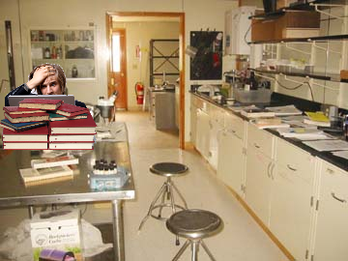
Retrieval Associating object and context
Autoassociation, What happens if we change the context
Context A
Paul’s research lab
Features
Context B
Hare Krishna convention
Features
Science stuff
Science stuff
Science stuff
Science stuff
Hare Krishna stuff
Hare Krishna stuff
Hare Krishna stuff
Hare Krishna stuff
Science stuff
Science stuff
Science stuff
Science stuff
0 | 0 | 1 | 1
0 | 0 | 1 | 1
0 | 0 | 1 | 1
0 | 0 | 1 | 1
Hare Krishna stuff
Hare Krishna stuff
Hare Krishna stuff
Hare Krishna stuff
1 | 0 | 0 | 1
1 | 0 | 0 | 1
1 | 0 | 0 | 1
1 | 0 | 0 | 1

Slide 36
Retrieval Associating object and context
Autoassociation, What happens if we change the context?
Combine Object & Context
Object
Paul the grad student
Context B
Hare Krishna convention
1) Sallow complexion / Hare Krishna stuff
2) Receding Hair Line / Hare Krishna stuff
3) Sunken eyes / Hare Krishna stuff
4) Five-o-clock shadow / Hare Krishna stuff
1 | 0 | 0 | 1
0 | 1 | 1 | 0
1 | 0 | 1 | 0
0 | 1 | 0 | 1
1 | 0 | 0 | 1
1 | 0 | 0 | 1
1 | 0 | 0 | 1
1 | 0 | 0 | 1

Slide 37
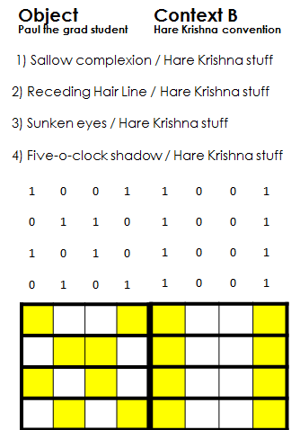
Retrieval Associating object and context
Memory retrieval with new contextual information
Paul out of context
Observe Paul with his new friends
Taking the inner Product
Correlation Matrix
1/1 | 0/0 | 1/0 | 1/1 | 0/0 | 0/0 | 1/0 | 1/1
0 | 1 | 1 | 1 | 0 | 0 | 1 | 1
1 | 1 | 1 | 0 | 0 | 0 | 1 | 1
1 | 1 | 0 | 1 | 0 | 0 | 1 | 1
0 | 0 | 0 | 0 | 0 | 0 | 0 | 0
0 | 0 | 0 | 0 | 0 | 0 | 0 | 0
1 | 1 | 1 | 1 | 0 | 0 | 1 | 1
1 | 1 | 1 | 1 | 0 | 0 | 1 | 1
= 3 2 3 2
= 2 3 2 3
= 2 3 3 2
= 3 2 2 3
= 0 0 0 0
= 0 0 0 0
= 3 3 3 3
= 3 3 3 3
3 2 2 3 0 0 3 3
4
= nonsense
This time we will look at all input/output retrieval
2 3 3 2 0 0 3 3
4
= nonsense
3 2 3 2 0 0 3 3
4
= nonsense
2 3 2 3 0 0 3 3
4
= nonsense
Notes:
Connection weght matrix de

Slide 38
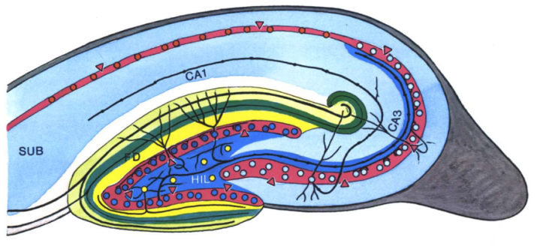
Associative Memory The “Complete” Hebb-Marr Model
Assumptions:
inhibition applied to dendrite will be subtractive
2) Inhibition applied to soma will be capable of performing division
Marr’s predictions based on his model:
Feed forward inhibition
(substraction)
Input from another codon cell
The inhibitory mechanism must implement a division operation on the excitation that reaches the cell
body from the dendrites.
S
: Subtracts “un-modifiable” excitatory component of the input
Inhibitory cells Types:
S: Substractive
G: Substractive
D: Divisive
G
: Subtracts (normalize to) number of inputs
S
Feedback inhibition
(substraction)
D
: Divides final output by all codon cell inputs
Ω
: Outputs and stores memory during recoding and recall
Feedback inhibition
(division)
Explicitly modeled by McNaughton-Morris
As well

Slide 39
Associative Memory The “Complete” Hebb-Marr Model
Assumptions:
inhibition applied to dendrite will be subtractive
2) Inhibition applied to soma will be capable of performing division
Marr’s predictions based on his model:
Feed forward inhibition
(substraction)
Input from another codon cell
Inhibitory cells can be much fewer in number than principal cells, but they must have extensive
connectivity.
S
: Subtracts “un-modifiable” excitatory component of the input
Inhibitory cells Types:
S: Substractive
G: Substractive
D: Divisive
G
: Subtracts (normalize to) number of inputs
S
Feedback inhibition
(substraction)
D
: Divides final output by all codon cell inputs
Ω
: Outputs and stores memory during recoding and recall
Feedback inhibition
(division)
Explicitly modeled by McNaughton-Morris
As well

Slide 40
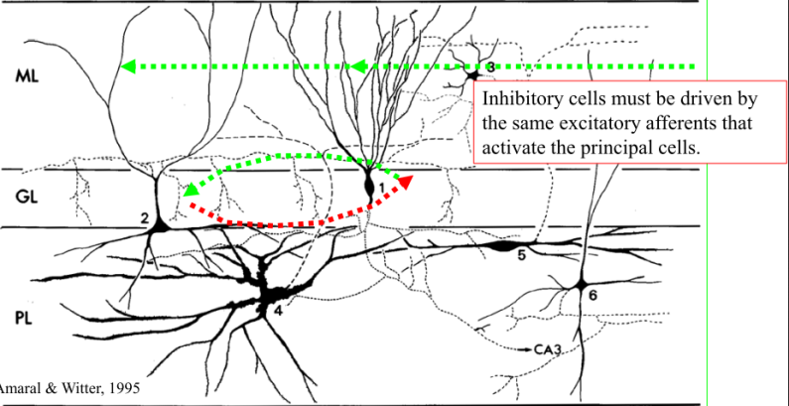
Associative Memory The “Complete” Hebb-Marr Model
Assumptions:
inhibition applied to dendrite will be subtractive
2) Inhibition applied to soma will be capable of performing division
Marr’s predictions based on his model:
Feed forward inhibition
(substraction)
Input from another codon cell
Inhibitory cells must be driven by the same excitatory afferents that activate the principal cells .
S
: Subtracts “un-modifiable” excitatory component of the input
Inhibitory cells Types:
S: Substractive
G: Substractive
D: Divisive
G
: Subtracts (normalize to) number of inputs
S
Feedback inhibition
(substraction)
D
: Divides final output by all codon cell inputs
Ω
: Outputs and stores memory during recoding and recall
Feedback inhibition
(division)
Explicitly modeled by McNaughton-Morris
As well

Slide 41
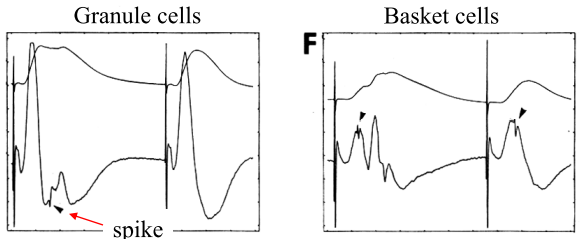
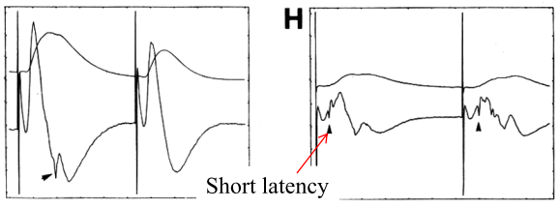
Associative Memory The “Complete” Hebb-Marr Model
Assumptions:
inhibition applied to dendrite will be subtractive
2) Inhibition applied to soma will be capable of performing division
Marr’s predictions based on his model:
Feed forward inhibition
(substraction)
Input from another codon cell
Inhibitory cells must respond to a synchronous input at lower threshold and at shorter latency
than principal cells.
S
: Subtracts “un-modifiable” excitatory component of the input
Threshold
Inhibitory cells Types:
S: Substractive
G: Substractive
D: Divisive
G
: Subtracts (normalize to) number of inputs
S
Feedback inhibition
(substraction)
Latency
D
: Divides final output by all codon cell inputs
Ω
: Outputs and stores memory during recoding and recall
Feedback inhibition
(division)
Explicitly modeled by McNaughton-Morris
As well

Slide 42
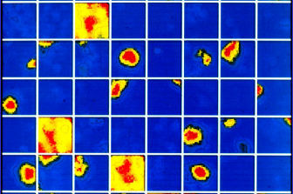
Associative Memory The “Complete” Hebb-Marr Model
Assumptions:
inhibition applied to dendrite will be subtractive
2) Inhibition applied to soma will be capable of performing division
Marr’s predictions based on his model:
Marr’s predictions based on his model:
Feed forward inhibition
(substraction)
Input from another codon cell
Whereas principal cells will be quite selective in their response characteristics, inhibitory
neurons will not be particular about which afferents are active at a given time, only about how
many are active
S
: Subtracts “un-modifiable” excitatory component of the input
Inhibitory cells Types:
S: Substractive
G: Substractive
D: Divisive
G
: Subtracts (normalize to) number of inputs
S
Feedback inhibition
(substraction)
D
: Divides final output by all codon cell inputs
Ω
: Outputs and stores memory during recoding and recall
Feedback inhibition
(division)
Explicitly modeled by McNaughton-Morris
As well

Slide 43
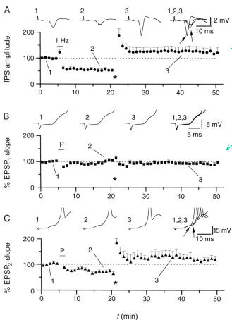
Associative Memory The “Complete” Hebb-Marr Model
Assumptions:
inhibition applied to dendrite will be subtractive
2) Inhibition applied to soma will be capable of performing division
Marr’s predictions based on his model:
Marr’s predictions based on his model:
Feed forward inhibition
(substraction)
Input from another codon cell
Excitatory synapses onto interneurons should not be plastic
S
: Subtracts “un-modifiable” excitatory component of the input
Inhibitory cells Types:
S: Substractive
G: Substractive
D: Divisive
G
: Subtracts (normalize to) number of inputs
S
Feedback inhibition
(substraction)
D
: Divides final output by all codon cell inputs
Ω
: Outputs and stores memory during recoding and recall
Feedback inhibition
(division)
Explicitly modeled by McNaughton-Morris
As well

Slide 44
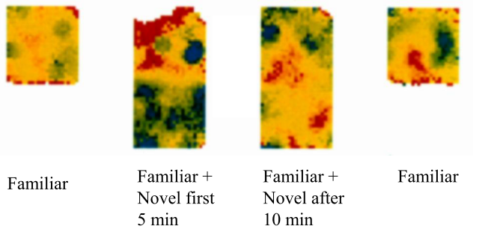
Associative Memory The “Complete” Hebb-Marr Model
Assumptions:
inhibition applied to dendrite will be subtractive
2) Inhibition applied to soma will be capable of performing division
Marr’s predictions based on his model:
Marr’s predictions based on his model:
Feed forward inhibition
(substraction)
Input from another codon cell
In unfamiliar situations (i.e. when current input elicits reduced output) extrinsic modulation of
inhibitory neurons might lower output threshold, successively probing for a complete pattern.
S
: Subtracts “un-modifiable” excitatory component of the input
Inhibitory cells Types:
S: Substractive
G: Substractive
D: Divisive
Heat-map of Interneuron activity
G
: Subtracts (normalize to) number of inputs
S
Feedback inhibition
(substraction)
D
: Divides final output by all codon cell inputs
Ω
: Outputs and stores memory during recoding and recall
Feedback inhibition
(division)
Explicitly modeled by McNaughton-Morris
As well

Slide 45
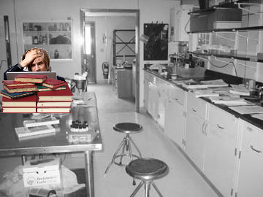
Fin.

