Slide 1
Psych 506A Presentation
Dendrites and Axons
Joe Cardoza

Slide 2
Imaging Techniques
http://www.youtube.com/watch?v=cwL3CWPM5vw&feature=related
http://www.youtube.com/watch?v=5MWHY8y9pSY
http://www.youtube.com/watch?v=dS_ONoUrptg

Slide 4
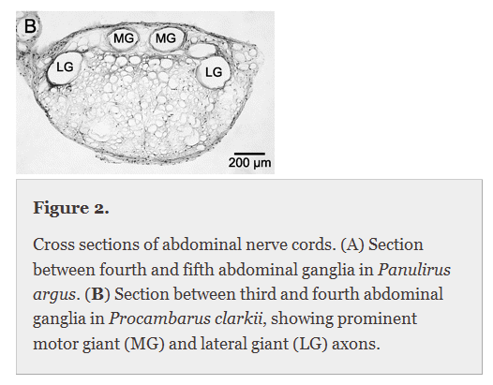
Giant Neurons in Cray Fish.
Medial Giants
Lateral Giants
Escape motorneurons
Latency of 10 ms
Incredibly fast tail flips

Slide 5
Tail Flipping

Slide 6
How are these latency times possible? Role of myelin.
Myelin increases speed of transmission three ways
Decreases ion leak across membrane through gaps, maximizing depolarization potential. Increases resistance, because it decreases conductance, no ion flow through insulation
Increases region between capacitor plates, creating less capacitance
Decreases the amount of action potentials needed for transmission of signal

Slide 7
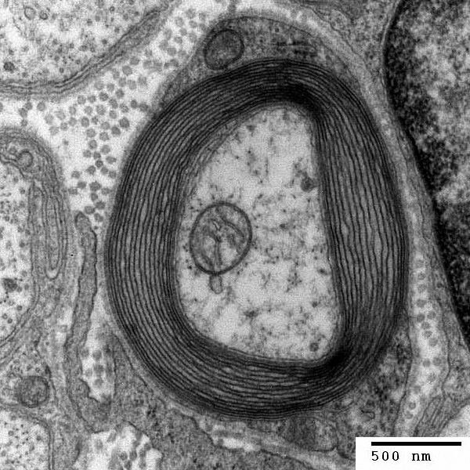
Examples

Slide 8
Loss of myelin and Neuropathies
multiple sclerosis – loss of myelin surrounding axons.
Could be autoimmune or genetic, inflammation
Symptoms range from
Muscle symptoms
Eye symptoms
Cognitive symptoms
Abnormal sensations etc.
Variety of problems, slowing of action potential propagation

Slide 9
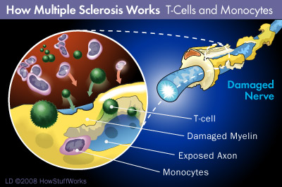

Slide 10
MRI images

Slide 11
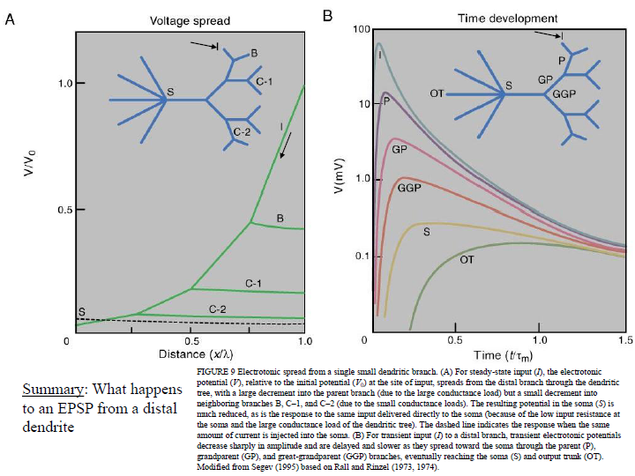

Slide 12
