Slide 1
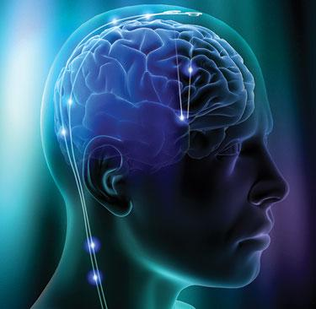
Neural Circuits By: Micah Price

Slide 2
Overview
Spinal Motor Neurons: Basic Circuit
Divergence/Convergence
Modulation of Pain (PAG)
Cochlea (Auditory System)
Thalamus
Glomeruli
Cerebellar Cortex

Slide 3
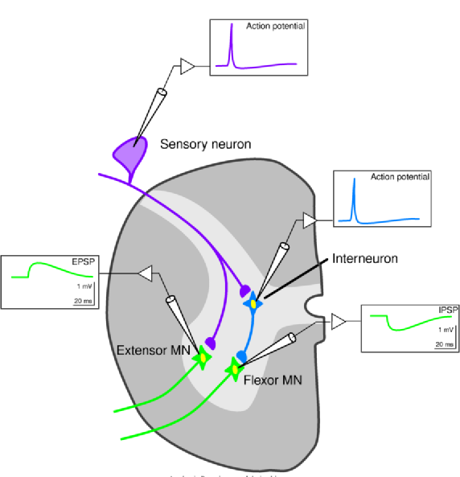
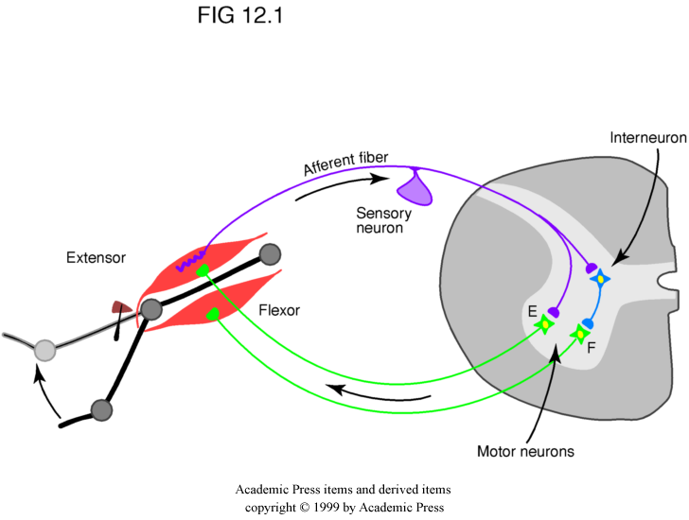
Spinal Motor Neuron: Basic Circuit
Patellar Reflex
Excitatory-Inhibitory Multiplexing
Multi-synaptic circuit=more flexibility and modulation

Slide 4
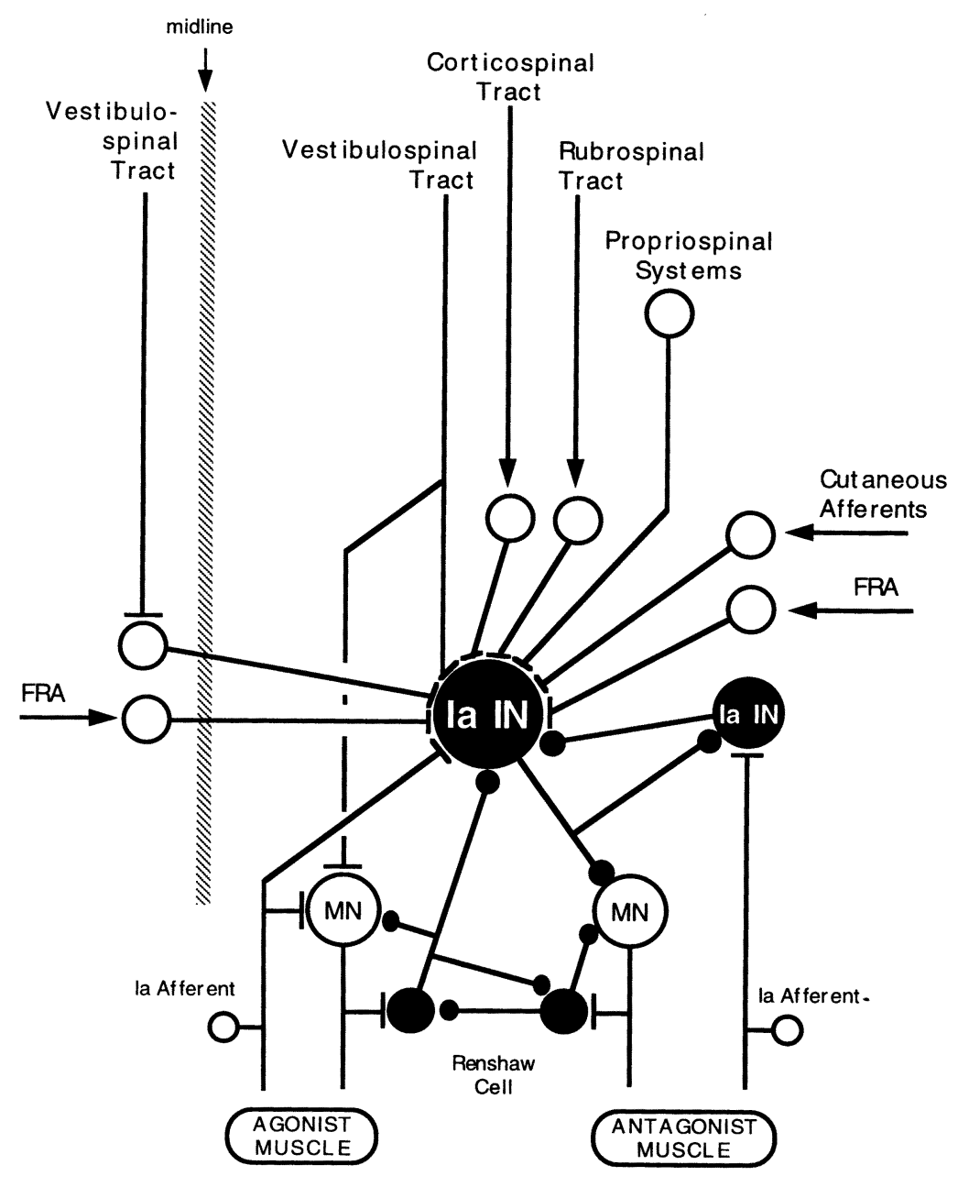
Interneuron
Target of many descending tracts from the brain. Interneuron can be used in more than just reflexes. It can be involved in voluntary movements like walking.

Slide 5
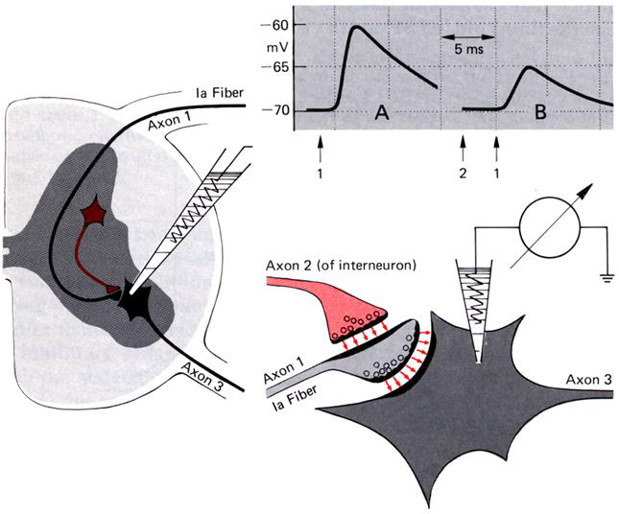
Presynaptic Inhibition
Increases Cl⁻ conductance by activating Glycine or GABA receptors
This decreases the amplitude of the action potential (less Ca²⁺entry)
Less neurotransmitter released from that terminal

Slide 6
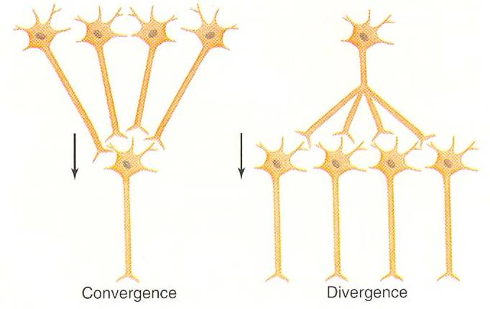
Convergence/Divergence
Many inputs to one neuron
Multiple Analysis Stream
One input to several neurons
Single Action/ Decision

Slide 7
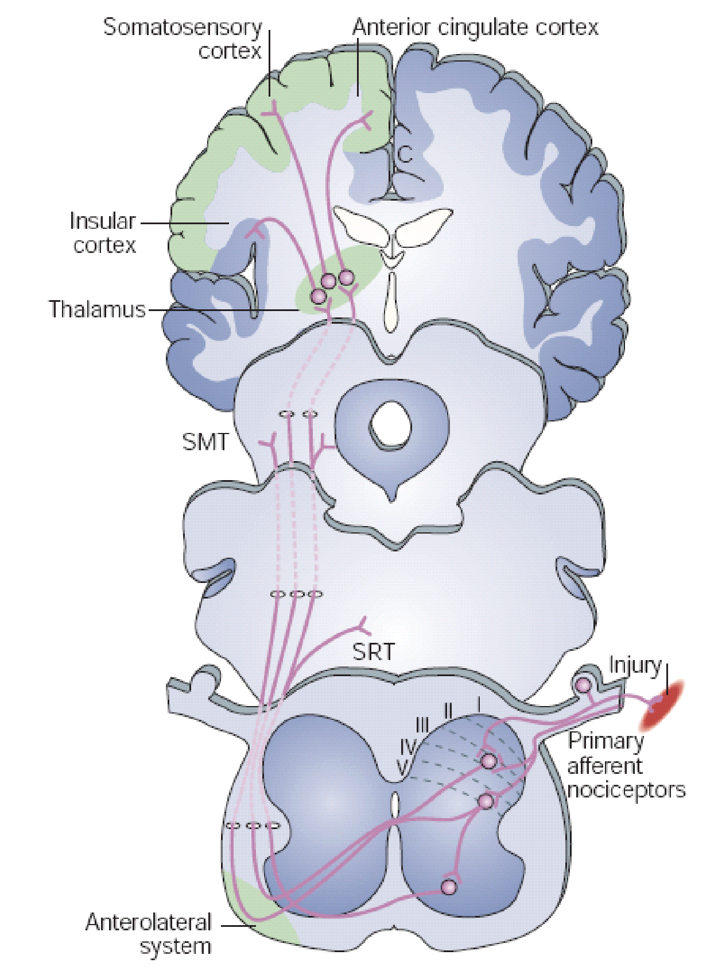
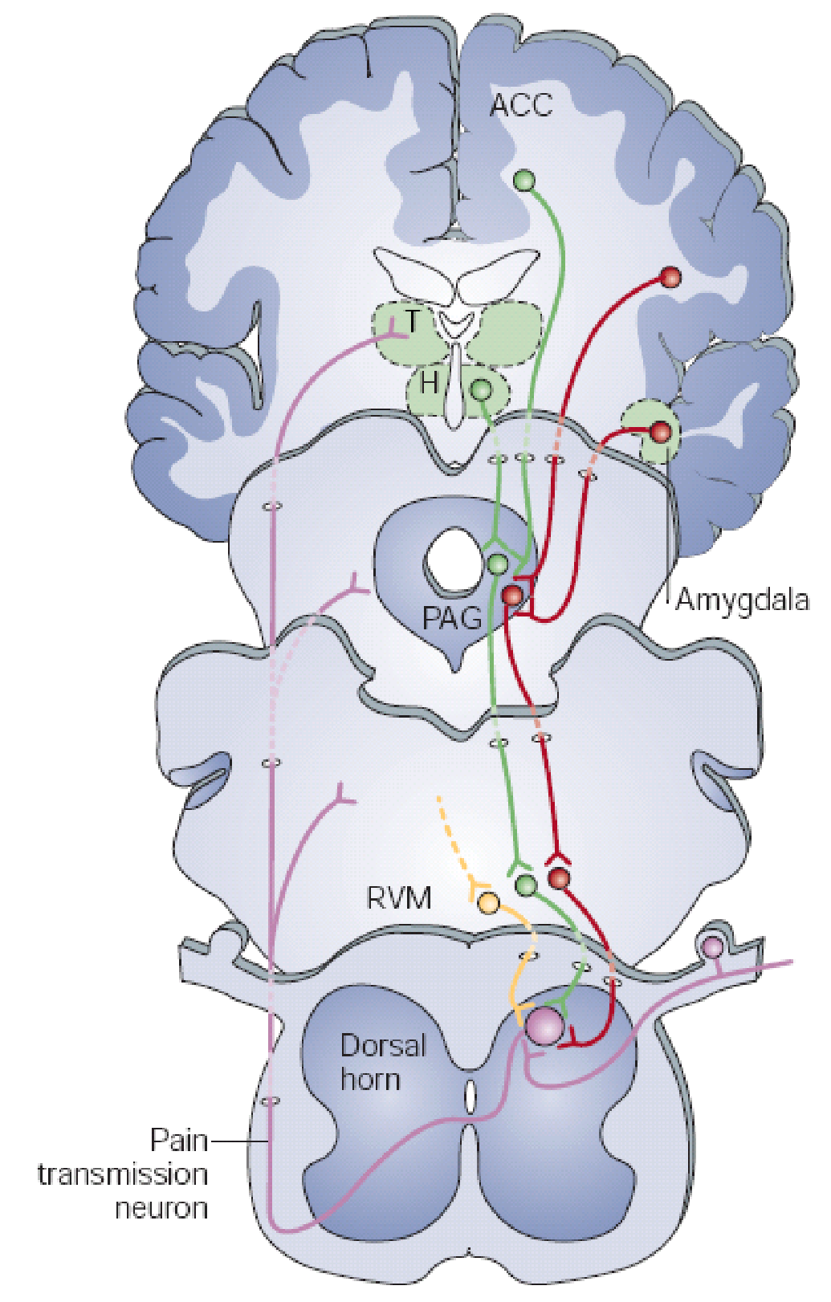
Pain Modulation
Location/Intensity
Emotional Aspect
Cognitive Aspects

Slide 8
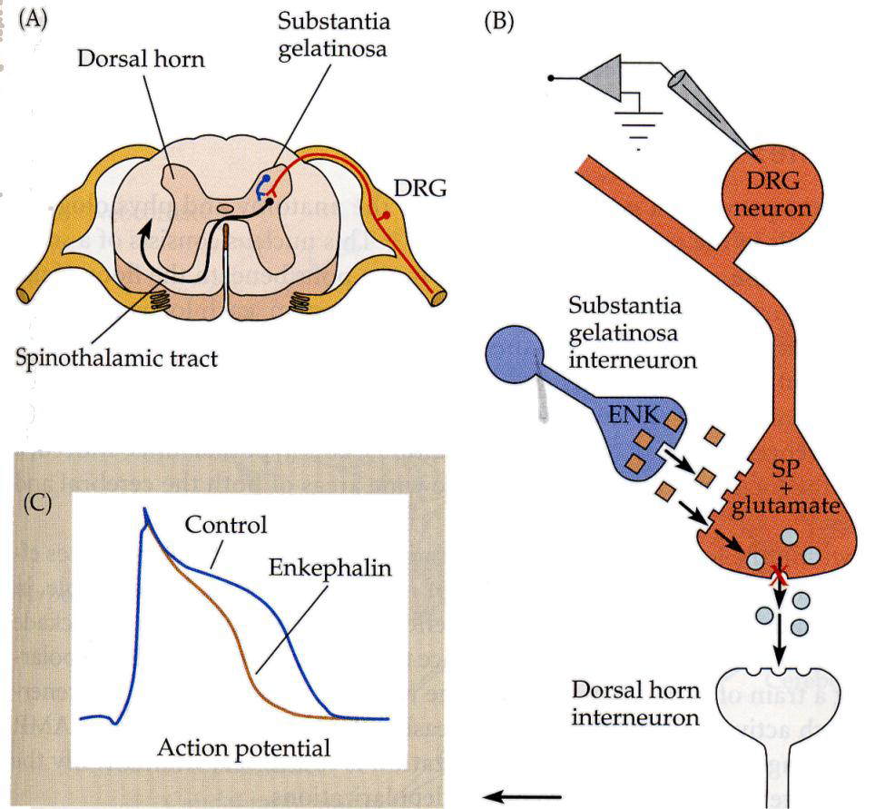
Neurons from the PAG eventually make it down to the substantia gelatinosa interneuron. It produces enkephalins (endogenous opiod neurotransmitter) to suppress the pain signal. It causes action potential change in shape and Ca2+ doesn’t rush in as much. Its neat because it can be controlled by cortical signals. (Hypnosis, Placebos, …)
Presynaptic inhibition

Slide 9
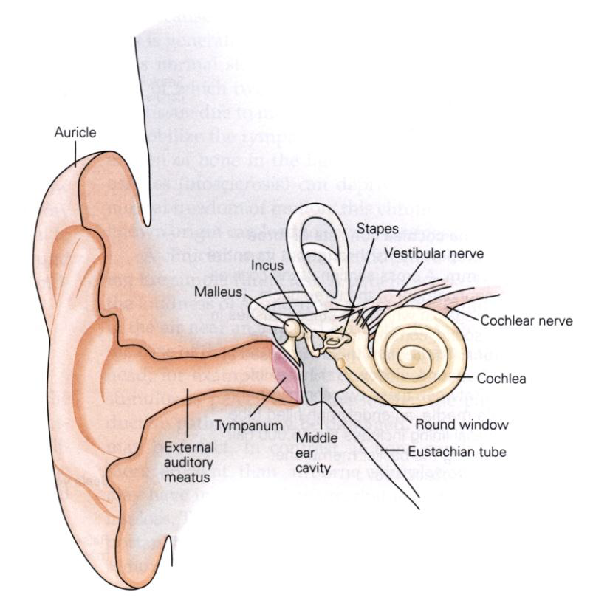
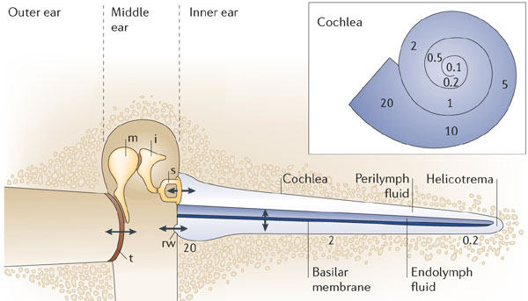
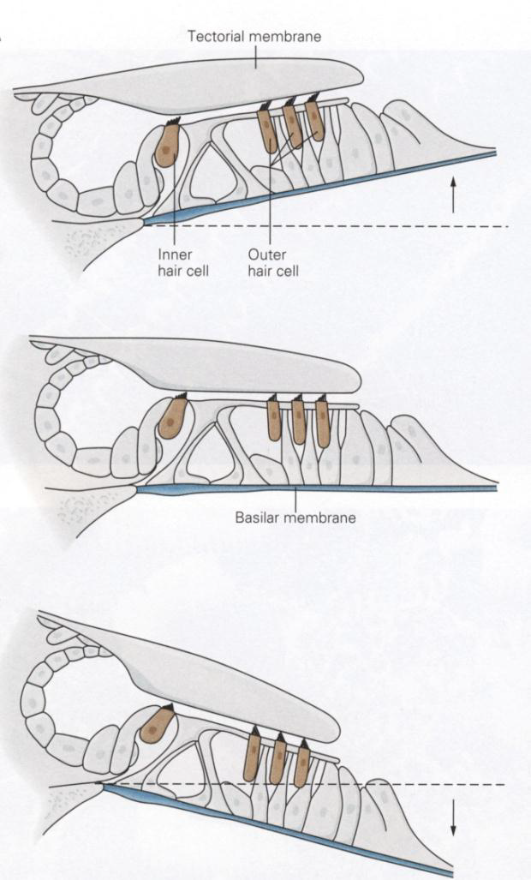
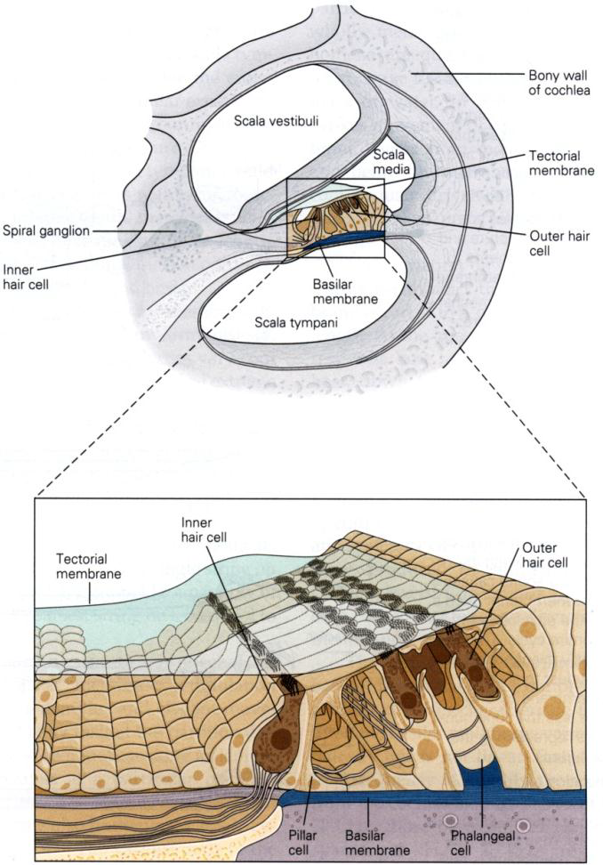
Cochlea
Sound travels through air, then becomes mechanical through bones and then pressure in liquid. This pressure moves the basilar membrane which moves the hair cells.

Slide 10
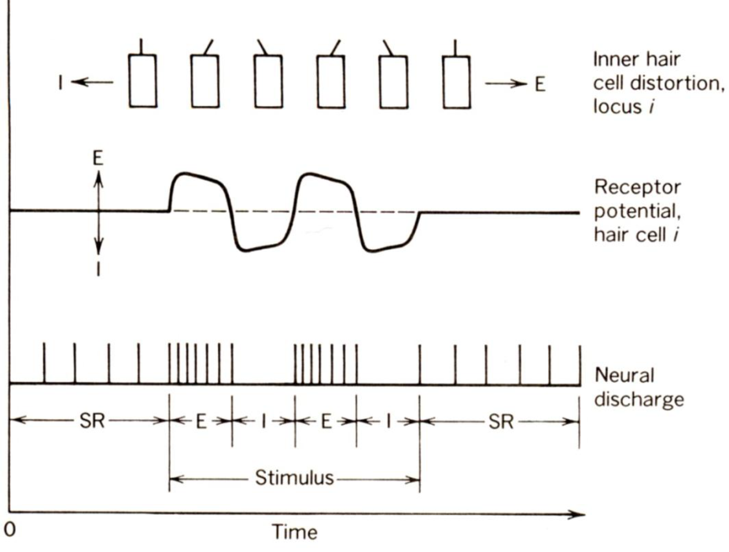
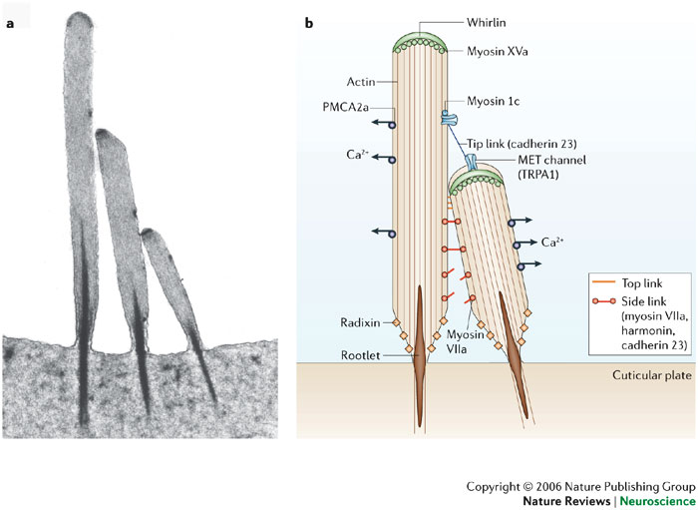
There is a string that is attached to the stereociliary bundles and when in bends one way, it opens ion channels. Depending on which way you bend will determine if it fires faster or if it fires more slowly/stops
Inner Hair cells are sensitive to the velocity of tectorial membrane vibration. Outer Hair cells provide feedback and amplify the amplitude and frequency of basilar membrane.

Slide 11
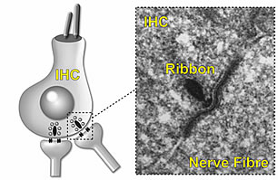
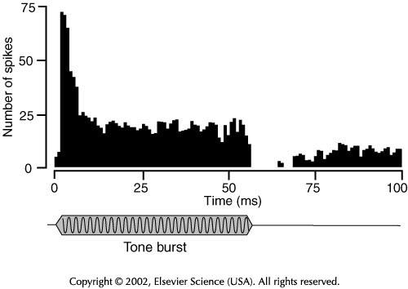
Ribbon Synapse
Auditory nerve fibers fire very quickly (100 Hz) so it needs a lot of neurotransmitters for release. Synaptic ribbons have vesicles tethered to it and it can release a lot at once and then sustain releasing slightly less amounts of neurotransmitter.

Slide 12
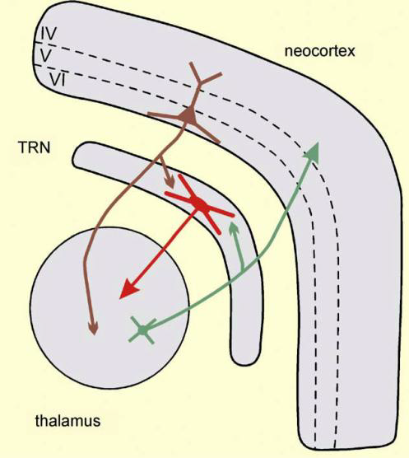
Thalamus
Cortical processing of all sensory information (except for smell) begins in the thalamus.
They mainly project to layer 4 of the cortex.
Descending corticothalamic cells come mainly come from layer 6 and there are far more returning to the thalamus than projecting from the thalamus.

Slide 13
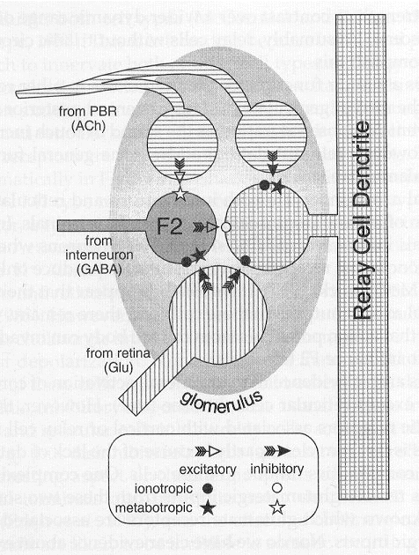
Corticothalamic modulatory feedback
CT fibers synapse on relay cells and inhibitory neurons in the reticular nucleus of the thalamus (TRN). (It can inhibit and facilitate its own inputs).
Relay Cells and TRN can be modulated by Ach from brainstem regions involved in attention and arousal.
Triadic Synapses help control excitatory inputs, cortical feedback and subcortical modulation
Glomeruli occur near base of relay cell, They isolate everything from surrounding structures. It allows retinal cells to strongly influence relay cells and allow interneurons to veto
Functional Implication
ACh: Attention (increase firing)
Interneuron: Gain Control (decrease firing)

Slide 14
Cerebellar Cortex
Purkinje Cells: Primary processing unit, provide the sole output via an inhibitory axon to the deep cerebellar nuclei which then project to the spinal cord and back to the cortex.
Granule Cells: form parallel fibers which extend perpendicularly to the PC. Synapse on to many PC but make few contacts(Excitatory)
Golgi Cells, Stellate and Basket Cells: Inhibitory interneurons
Mossy Fibers: carry information from cerebellar nuclei, vestibular nuclei, reticular formation, spinal cord and most of the cortex to the granule cells. Thought to carry the context of a motor action. (Excitatory)
Climbing Fibers carry information from inferior olivary complex and then synapses on the Purkinje cells and serves as a training signal (US) during motor learning. Only contact few Purkinje Cells but they make many contacts with it. (Excitatory)

Slide 15
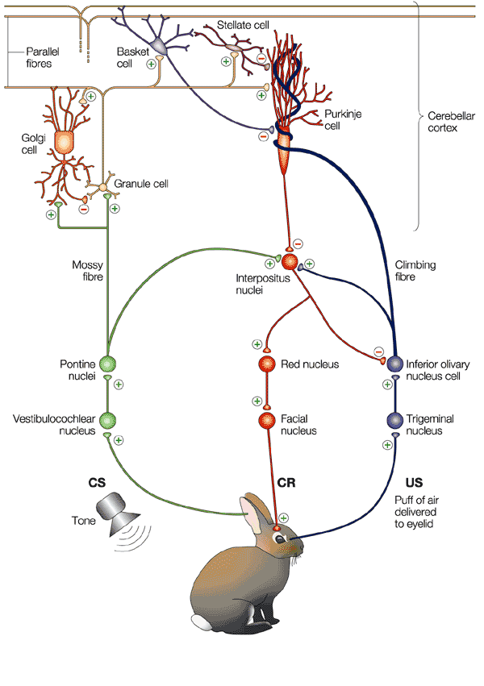
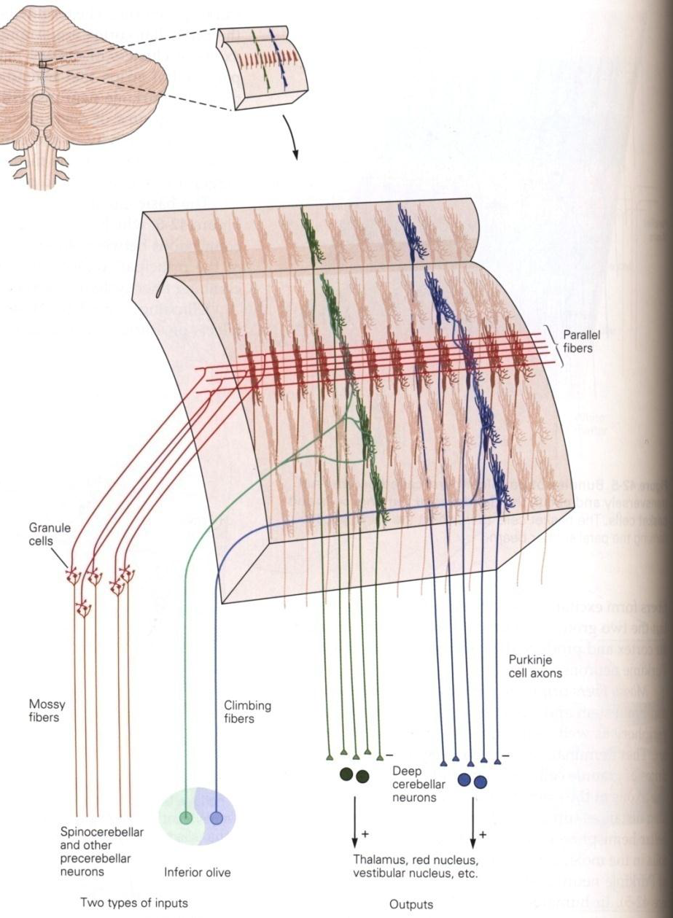
Diagrams for inputs and outputs and for learning a motor response

Slide 16
Granule cell and mossy fiber synapses also occur in a glomerulus.
Increases synaptic efficacy
Increases synaptic independence
When learning, some form of movement, the Purkinje cells each hypothesize the correct movement. Climbing fibers carry a signal to the last activated Purkinje cell to weaken its contacts with parallel fibers until it eventually stops firing. When Parallel fibers and Climbing fibers are active simultaneously, parallel fibers lose their connection with the PC.
It is done through metabotropic glutamate receptors and increased Ca2+ in the cell, inactivates AMPA receptors

Slide 17
Conclusion
There are many circuits within the Nervous System.
Modulation of Pain (PAG)
Cochlea (Auditory System)
Thalamus
Cerebellar Cortex
Reflexes
Many, many more
They can all be modulated by inhibitory interneurons or by neuromodulators.
Circuits have found ways to make synapses more efficient (glomerulus).

