Slide 1
Sleep and Memory
PSYC 506A
Natalie Bryant

Slide 2
Dr. William C. Dement
“Dreaming permits each and every one of us to be quietly and safely insane every night of our lives.”
William Dement, in Newsweek, 1959

Slide 3
Sleep
Current research
Sleep basics
Neural bases
Computations

Slide 4
Sleep
Current research
Sleep basics
Neural bases
Computations

Slide 5
Measuring Sleep
EOGs
EMGs
EEGs
EKGs

Slide 6
Hypnogram
beta
alpha
“theta”
“spindle”
K-complex
SWS
delta (SWA)
theta

Slide 7
Sleep-Wake Homeostasis
S = Sleep Pressure
C = Circadian Rhythm
Borbély, Human Neurobiology, 1982

Slide 8
Sleep
Current research
Sleep basics
Neural bases
Computations

Slide 9
Sleep
Current research
Sleep basics
Neural bases
Computations

Slide 10
SWS
Arousal neurotransmitters ACh, NE, 5-HT and histamine
VLPA region responsible for sleep
Wake
inhibition

Slide 11
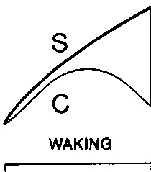
SWS
Build up of adenosine
Arousal neurotransmitters ACh, NE, 5-HT and histamine
VLPA region responsible for sleep
Wake
Shut down of hypocretinergic neurons
Sleep
inhibition

Slide 12
REM
REM differs from SWS
Cortical activity is desynchronized
Bursts of activity (PGO waves) that occur in time with rapid eye movements
Muscular paralysis
What is coordinating all these systems?
There must be some sort of “central system” (Hobson, 1988)
Hobson said, “let’s look at the brainstem!”
Knows how to network

Slide 13
Hobson’s Flare for the Dramatic
"The brainstem is a nightly battleground of warring neuronal factions, and REM sleep and dreaming are the result of temporary domination of one neuronal population over another. Victorious is a troop of reticular formation neurons concentrated mainly in the pontine portion of the brain stem; owing to their fusillades of firing in association with REM-sleep events, these pontine reticular neurons are likely to play the executive role in the generation of REM sleep and dreaming. Sharing the white flag of temporary surrender is a population of aminergic neurons located in the locus ceoruleus, the raphe nuclei, and the paribrachial regions of the anterior pontine brain stem; hardly a shot is fired by this neuronal phalanx during REM sleep. By virtue of this ceasefire, these aminergic neurons are likely to play a permissive role in the generation of REM sleep."
Hobson, The Dreaming Brain, 1988

Slide 14
Hobson’s Reciprocal-Interaction Model for REM
NREM
Cholinergic
“REM-on” neurons in MPRF
Aminergic
“REM-off”
neurons in brainstem
Raphe nuclei
Locus coeruleus
Paribrachial regions
inhibition

Slide 15
Hobson’s Reciprocal-Interaction Model for REM
Aminergic
“REM-off”
neurons in brainstem
Cholinergic
“REM-on” neurons in MPRF
NREM
Cortical activation
REM
Excitatory Influence
inhibition
PGO waves and REMs
Muscle atonia

Slide 16
Sleep
Current research
Sleep basics
Neural bases
Computations

Slide 17
Sleep
Current research
Sleep basics
Neural bases
Computations

Slide 18
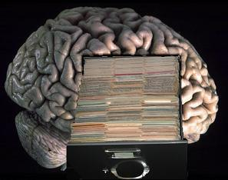
Memory Consolidation
Memory consolidation
Filing system of memory
Replay (“reactivation”)
Hippocampus
Compare
Store through integration or delete
Cortex
Evidence in rats

Slide 19
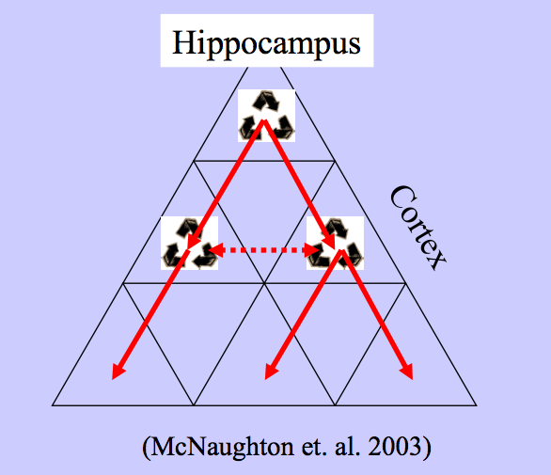
Hippocampus ←→Cortex Interaction
Memory replay/reactivation
Cortical integration/consolidation

Slide 20
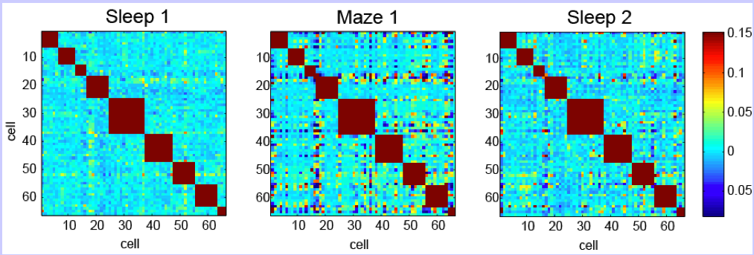
Rat Hippocampal Cells
More correlated than Sleep 1
Memory trace reactivated or maintained during sleep

Slide 21
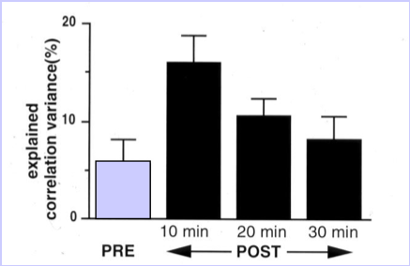
Time-dependent
Reactivation is strongest in first 10 minutes
Correlation decays with time

Slide 22
Sleep
Current research
Sleep basics
Neural bases
Computations

Slide 23
Sleep
Current research
Sleep basics
Neural bases
Computations

Slide 24
NREM/Sleep Onset Dreams
Reactivation
in rats
Veridical replay
Combined with other memory traces
Reflection of memory consolidation process (abstraction)
Wamsley, E., Stickgold, R. (2010) Sleep Medicine Clinics.
Notes:
These dreams, which tend to be highly hypnogogic in nature, start with veridical replay of the interactive learning task early in the night. However, what they found was that as sleep progressed, the reported mentations seemed to combine with other memory traces, indicating that memories were being consolidated and abstracted as the night went on. This is consistent with the Payne and Nadel’s hypothesis that as hippocampal involvement decreases, the memory replay became less dependant on this structure and more integrated in the existing neocortical networks.

Slide 25
Rats vs. Humans
Hippocampal involvement?

Slide 26
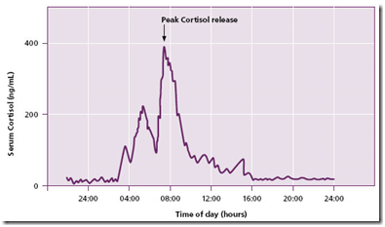
The Role of Cortisol
Low cortisol = hippocampal involvement
Episodic dreams representing recently acquired memory trace
Payne, J., Nadel, L. (2004) Learning and Memory.
Notes:
Evidence for this can be found in the varying levels of cortisol during sleep. This hormone, which is known to disrupt hippocampal function, is at its lowest level early in the night, when NREM sleep is most prevalent. Therefore, the hippocampus, which is responsible for declarative memory processing, is communicating with other structures at a normal level when cortisol levels are low. This may account for the episodic dreams experienced during NREM.

Slide 27
The Role of Cortisol
High cortisol = disrupted
hippocampal ←→ neocortical communication
Cortex communicates with self; synthesizes memory traces into story
Notes:
As the night progresses, cortisol release increases, which disrupts the hippocampal/neocortical communication necessary for episodic memory processing. Without hippocampal input, the neocortex (where our associations are stored) activates memory fragments and concepts, which become synthesized into a dream narrative or story, which is often complex in nature.

Slide 28
Hippocampus ←→Cortex Interaction
Low cortisol = high hippocampal involvement
High cortisol = less hippocampal involvement
Cortical integration

Slide 29
References
Borbély, A. (1982). A two process model of sleep. Human Neurobiology 1, 195-204.
Hobson, J. (1988). The Dreaming Brain. New York, NY: Basic Books.
Kalat, J. (2003). Biological Psychology (8th Edition). Belmont, CA: Thomson Learning, Inc.
Kudrimoti,H..et al. (1999). Reactivation of hippocampal cell assemblies: Effects of behavioral state, experience, and EEG dynamics. Journal of Neuroscience 19, 4090–4101. Retrieved from wiki.brown.edu on October 15, 11.
Payne, J., Nadel, L. (2004). Sleep, dreams, and memory consolidation: The role of the stress hormone cortisol. Learning and Memory 11, 671-678.
Wamsley, E., Stickgold, R. (2010). Dreaming and offline memory processing. Current Biology 20, 1010-1013.
Wilson, M., McNaughton, B. (1994). Reactivation of hippocampal ensemble memories during sleep. Science 265, 676-679. Retrieved from PubMed database on October 15, 11.

