Slide 1
Summary of 1st lecture
Intro to computational modeling and neural networks

Slide 2
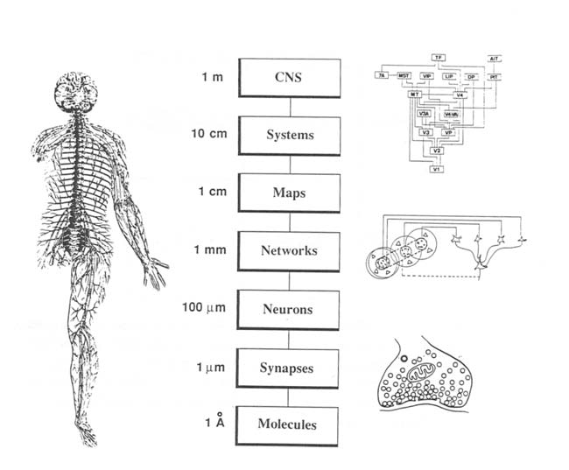
Complexity of the human brain
10¹¹ neurons in a human brain
10¹⁵ synapses in a human brain
Probability of connection between 2 cortical cells: 3%/mm³
Spatial scales within a given brain: 10 orders of magnitudes from molecules to system.
Which scale?: Depends on behavior and (may) vary in time.

Slide 3
Models
Try to simplify a complex system in order to gain insights
A good model will allow for testable predictions to check if your on the right track
3 major levels:
AI
Connectionist
Biophysical

Slide 4
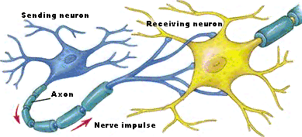
(McCulloch and Pitts 1943): first algorithmic formulation of a neuron.

Slide 5
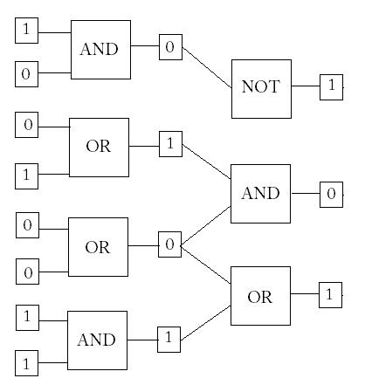

Slide 6
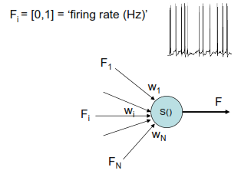
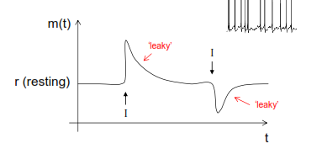
Firing Rate Models
Can go further and incorporate time and “leakiness”

Slide 7
Networks
Pyramidal cells project from cortex
Connected up by local interneurons
Organized into columns

Slide 8
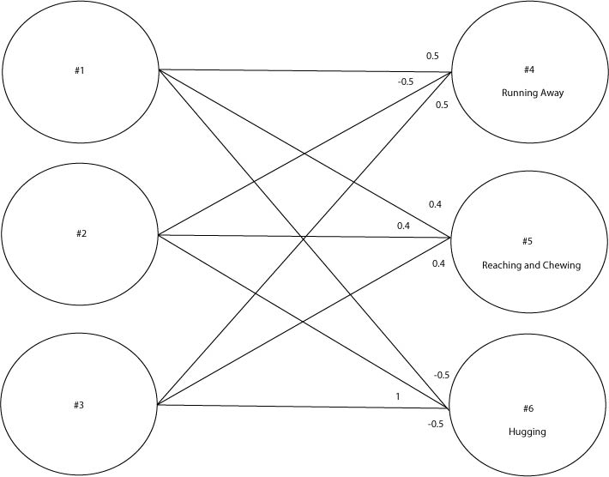
Connecting M.P. Neurons
neurons #1 and #3 are activated by seeing a snake
all three neurons are activated by the image of some spaghetti
neuron #2 alone is activated by seeing your mother.

Slide 9
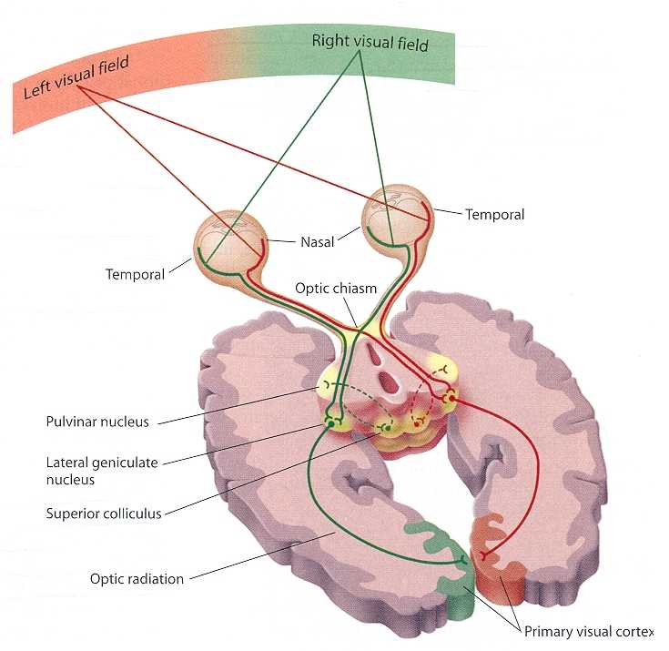
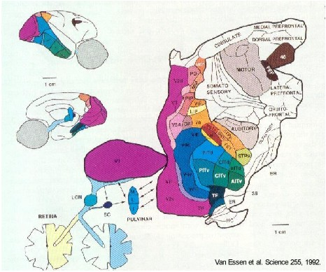
Feature Abstraction
Areas specialized to abstract color, motion, form, texture, edges etc.

Slide 10
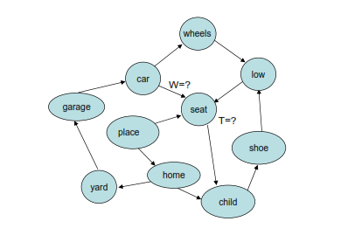
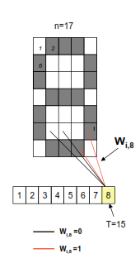
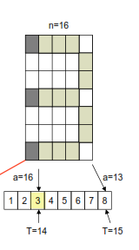
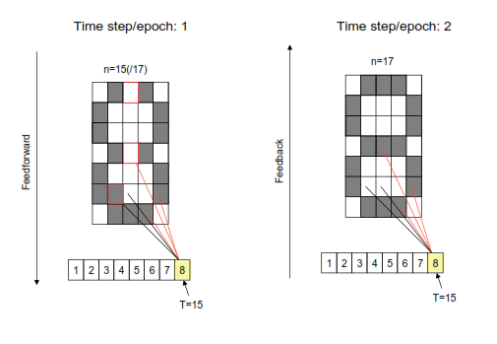
Simulating networks

Slide 11
Learning
Simultaneous inputs
weak
strong
strong
strong

Slide 12
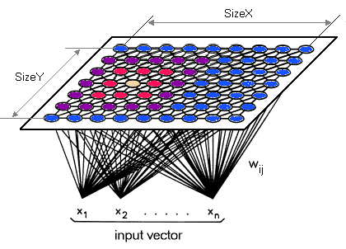
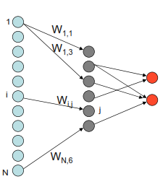
Learning
Correct/
Incorrect?

Slide 13
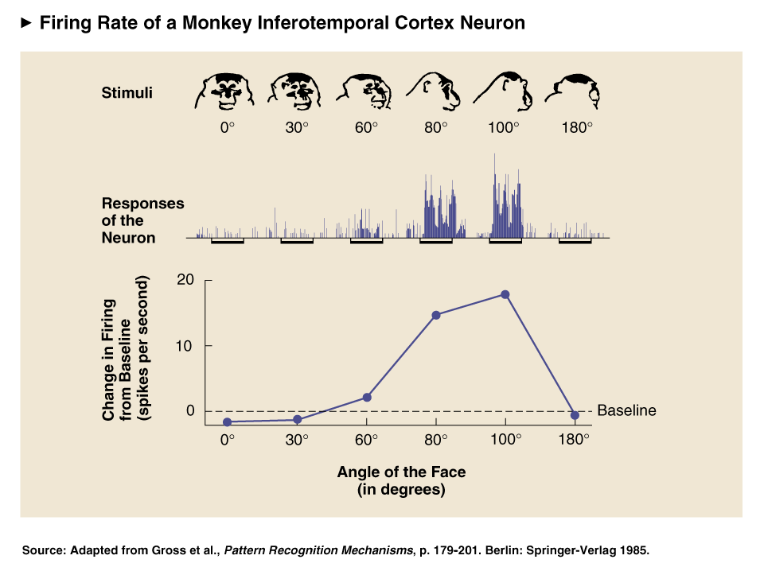
Face Selective Temporal Lobe Neurons

Slide 14
Facial Recognition Network

Slide 15
Facial Recognition

Slide 16
Connectionist vs Biophysical
Connectionist uses model neurons
Simple “integrate and fire” (firing rate, leaky integrator)
Perceptron, feature abstraction, pattern completion
Biophysical
How messy, noisy neurons actually do it
Modeling membrane conductance, ion channel density, changes in spike width/height,
But can model some higher level things (with more difficulty)

