Slide 1
Neuroimaging (& aging)
Vanessa Lux

Slide 2
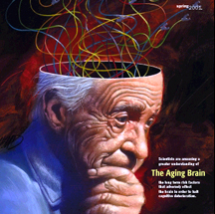
The aging brain
Changes in brain structure, function and cognition
Frontal cortex especially affected
wide variability in changes and thus performance
Research: What accounts for heterogeneity?
MRI
PET
fMRI

Slide 3
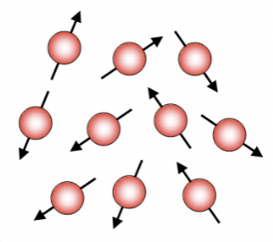
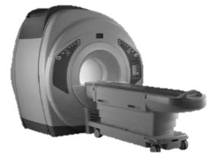
Magnetic Resonance Imaging (MRI)
how it works
pros and cons
application in research
water and fat in body contain hydrogen atoms
mini magnets with north and south pole
random orientation
strong magnetic field
atoms in body align in the direction of the field
precession at characteristic speed
(out of phase → no overall magnetization vector)
Notes:
Can‘t align directly, thus precession around their axis

Slide 4
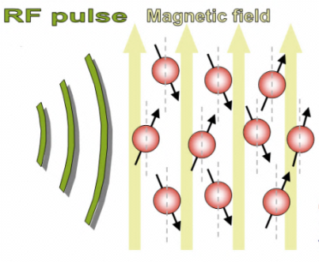
Magnetic Resonance Imaging (MRI)
how it works
pros and cons
application in research
brief radiofrequency pulse
phase of spins is aligned
overall magnetization vector transferred to XY plane
2 forms of relaxation
T2: dephasing of spins, fast, magnetization vector is reduced
T1: return to equilibrium of spin states, slow, magnetization vector is restored
Notes:
Simultaneous relaxations with diff time courses

Slide 5
Magnetic Resonance Imaging (MRI)
how it works
pros and cons
application in research
Different tissues have different T1 and T2 relaxation rates
Different signal intensity at a given time period after radiofrequency pulse
Visualized as a gray scale applied to image
Variatian of pulse parameters of MRI scanner: weighting of image towards T1 or T2 relaxation →image different types of tissue
Notes:
Simultaneous relaxations with diff time courses

Slide 6
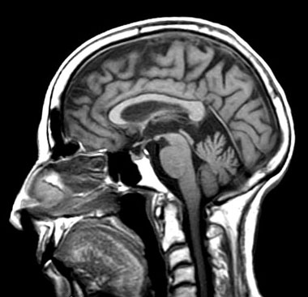
Magnetic Resonance Imaging (MRI)
how it works
pros and cons
application in research
excellent tissue contrast
non-invasive
good spatial resolution
variety of measures (e.g. diffusion tensor imaging)
detection of atrophy and white matter abnormalities
does not detect bone
very expensive
static images
contraindicated for pacemakers and other metal implants
Notes:
Dti: measures diffusion of water molecules: connectivity maps of the brain

Slide 7
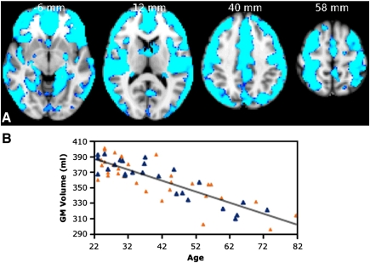
Magnetic Resonance Imaging (MRI)
how it works
pros and cons
application in research
Giorgio et al., 2010
→ Imaging gray matter volume reduction in aging
Fig. 1
VBM-style analysis of GM changes with age. (A) Coloured voxels show regions demonstrating significant negative correlations between GM volume and age (p < 0.05, fully corrected for multiple comparisons across space). Clusters are overlaid on the MNI152 template brain. Images are shown in radiological convention. (B) Plot to illustrate relationship between age and mean GM volume across all significant voxels. The orange triangles represent female subjects

Slide 8
Positron emission tomography (PET)
how it works
pros and cons
application in research
Short-lived radioactive tracer isotope (incorporated into biologically active molecule) injected into living subject
Waiting period: molecule becomes concentrated in tissues of interest →subject placed into scanner
Scan: record of tissue concentration as tracer decays
Positron is emitted during decay
travels in tissue until it collides with an
electron
Electron and positron annihilate, producing gamma photons moving in opposite directions
Notes:
Injectes into blood circulation

Slide 9
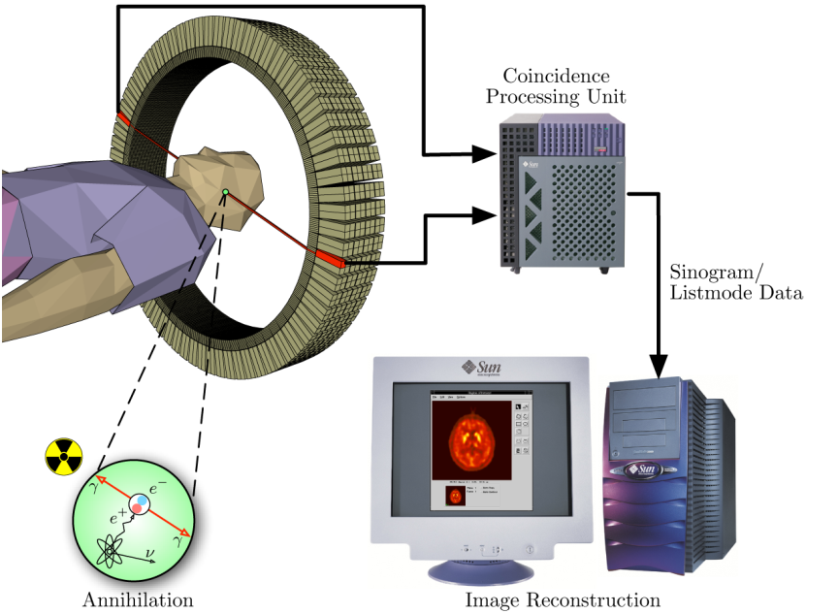
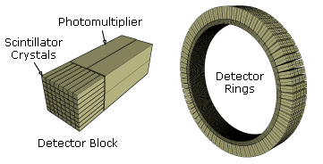
Positron emission tomography (PET)
how it works
pros and cons
application in research
Gamma photons are detected by scintillator in scanning device → burst of light is created and detected by photomultiplier tubes.
Technique depends on coincident detection of the pair of photons moving in opposite directions
Annihilation event location can be inferred from gamma photons

Slide 10
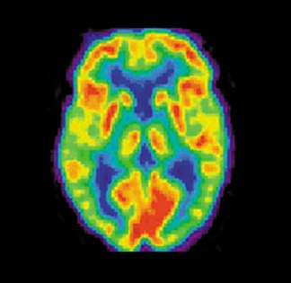
Positron emission tomography (PET)
how it works
pros and cons
application in research
Image construction
Statistics collected from tens of thousands of coincidence events
Coincidence event: line in space connecting two detectors
Resulting map shows tissues in which tracer has become concentrated

Slide 11
Positron emission tomography (PET)
how it works
pros and cons
application in research
adds metabolic information to anatomical imaging (patient does not need to change position)
can be used to trace biologic pathway of any compound in living organisms
invasive
high costs for cyclotrons
radiotracers have short half-lives
image construction is difficult (preprocessing & corrections)
Notes:
Preprocessing & several correctiond

Slide 12
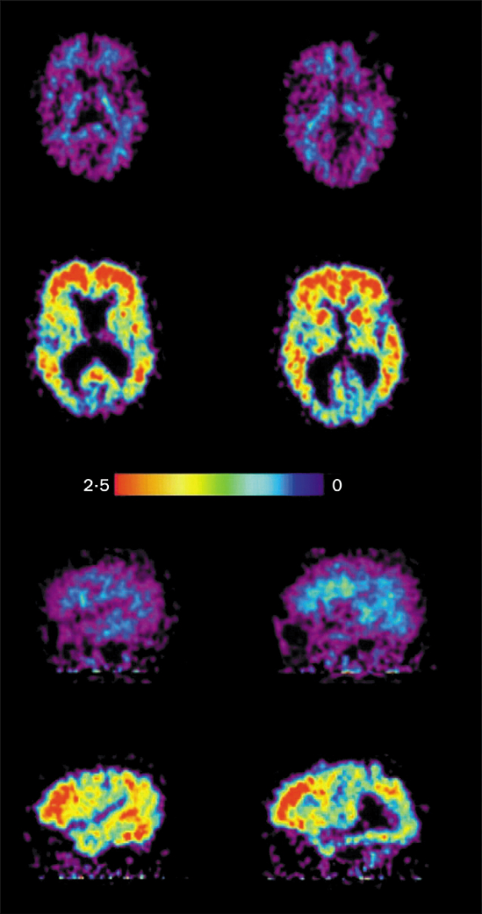
Positron emission tomography (PET)
how it works
pros and cons
application in research
Nordberg, 2008
→ Imaging amyloid in Alzheimer‘s disease
Figure 7. Serial planes showing the topography of 11C-PIB retention in the brain of a control individual and a patient with AD. Top two rows show axial and bottom two show sagittal standardised uptake values (SUV) of PIB images. Images from the the control individual are shown in rows one and three and the corresponding data from the patient with AD are shown
in rows two and four. The scale bar indicates relative levels of PIB SUV values. Reproduced with permission from Wiley-Liss Inc.39

Slide 13
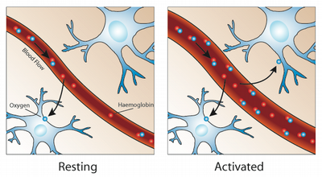
Functional Magnetic Resonance Imaging (fMRI)
how it works
pros and cons
application in research
Idea: measure changes in blood oxygenation and flow related to CNS activity (hemodynamic response)
Neuronal activity: glucose and oxygen delivered through blood stream (hemoglobin)
→ oxyhemoglobin>deoxyhemoglobin
(diamagnetic) (paramagnetic)

Slide 14
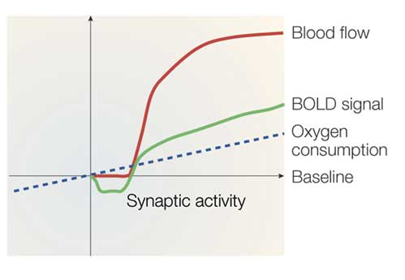
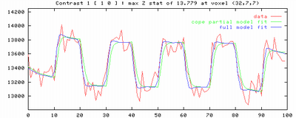
Functional Magnetic Resonance Imaging (fMRI)
how it works
pros and cons
application in research
The greater the dominance of oxyhemoglobin, the higher the BOLD signal
Experiment gives a timecourse of events
Activity in a voxel: degree of signal overlap with that timecourse
Tight correspondence: high activation score
No correlation: low score
Deactivation: negative score
→activation map
Notes:
Dip: decrease in blood oxygenation

Slide 15
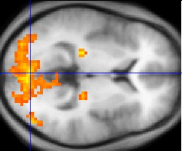
Functional Magnetic Resonance Imaging (fMRI)
how it works
pros and cons
application in research
good spatial resolution (1-3 mm)
Can record from all brain regions
Non-invasive
temporal resolution: better than PET, worse than EEG
expensive
restricted to certain types of tasks
indirect measure of neuronal activity
BOLD can be influenced by various factors
Notes:
Age, drugs, pathology, attention

Slide 16
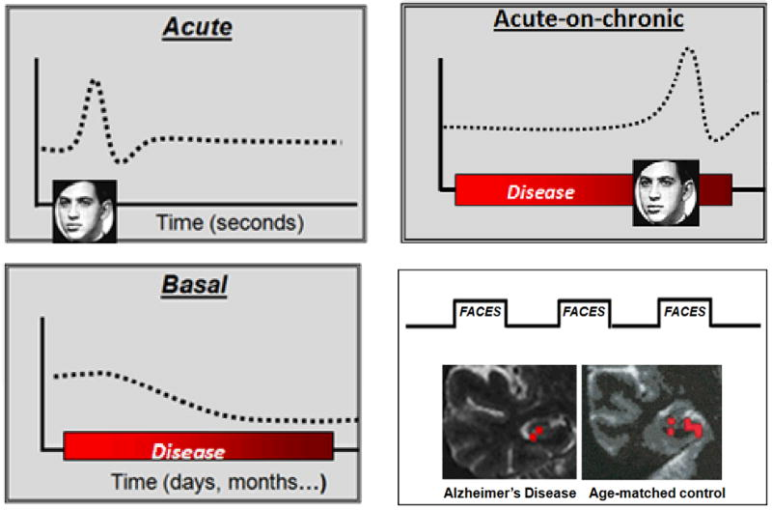
Functional Magnetic Resonance Imaging (fMRI)
how it works
pros and cons
application in research
Brickmann et al., 2010
→ Mapping synaptic loss in Alzheimer‘s disease
fMRI approaches for mapping synaptic loss
fMRI can map acute stimulus-evoked changes in metabolism (upper left panel, in which flashing faces illustrate external stimulation), or can map disease-associated changes in basal metabolism (lower left panel). Synaptic loss in Alzheimer' disease can be detected by mapping basal changes or by using an ‘acute-on-chronic’ paradigm, in which stimulus-evoked changes are measured ‘on top’ of basal changes (upper right panel). The acute-on-chronic approach has been used to show differences in stimulus-evoked fMRI responses in the hippocampal formation, comparing Alzheimer' disease to healthy controls (lower right panel).

Slide 17
conclusions
Imaging techniques are helpful for investigating the mechanisms underlying brain changes in healthy & pathological aging
Early detection
Tracking progression
Evaluate treatments and prevention therapies

